Slide 1
LGBTQ+ IN SOCIAL WORK EDUCATION AND PRACTICE
Alfonso Pezzella (he/him), SFHEA, MBPsS
Lecturer and Programme Leader in Mental Health
a.pezzella@mdx.ac.uk @AlfPezzella
North London Social Work Teaching Partnership
22nd November 2022

Slide 2
Pre-session activity Activity
Go to www.menti.com and use the code 7849 8866
https://www.menti.com/alqhg9wp2iru

Slide 5
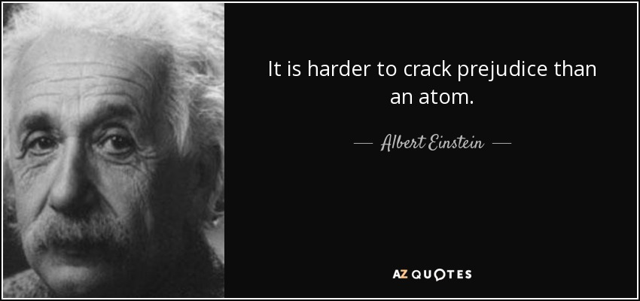

Slide 6
Micro-aggression
Lack of social engagement
Discrimination against LGBT+ people continue to exist in the UK
Not disclosing gender or sexual identity
Poor mental/physical health
Isolation/dropping out
Internalised sexual stigma
Poor academic performance

Slide 7
WHAT DO WE MEAN BY CULTURE?
Culture is the shared way of life of a group of people that includes beliefs, values, ideas, language, communication, norms and visibly expressed forms such as customs, art, music, clothing, food, and etiquette.

Slide 8
WHAT DO WE MEAN BY CULTURE?
Culture influences individuals’ lifestyles, personal identity and their relationship with others both within and outside their culture.
Cultures are dynamic and ever changing as individuals are influenced by, and influence their culture, by different degrees (Papadopoulos and Lees 2003).
CULTURAL COMPETENCE

Slide 9
CULTURAL COMPETENCE
Cultural competence is the capacity to provide effective healthcare taking into consideration people's cultural beliefs, behaviours and needs.
Cultural competence is both a results from the synthesis of knowledge and skills which we acquire during our personal and professional lives (to which we are constantly adding) and its application in the assessment of clients’ needs, clinical diagnosis and other caring skills.
A most important component of this stage is the ability to recognise and challenge racism and other forms of discrimination and oppressive practice.
CULTURAL COMPETENCE

Slide 10
LGBTQ+ issues
Homosexuality is still illegal in 72 countries, of which 8 have the death penalty.
What does it mean to be LGBTQ+ in a different country?
Pronouns and inclusive language
Personal views of LGBTQ+ people
Facilities

Slide 11
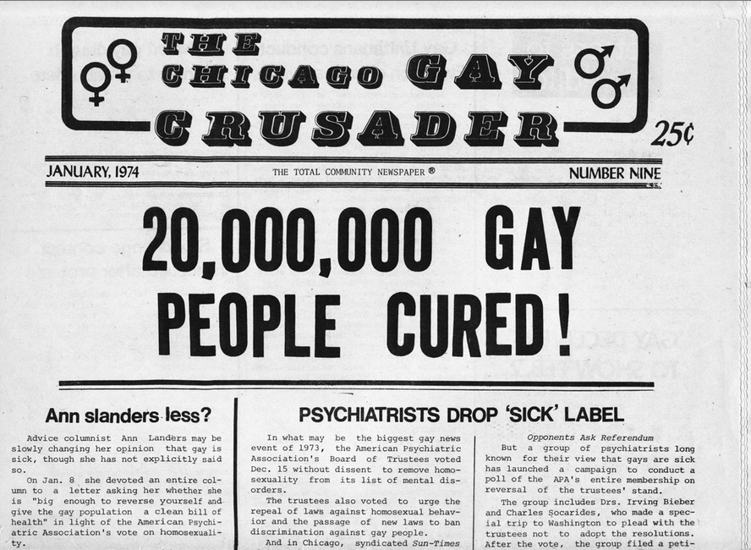
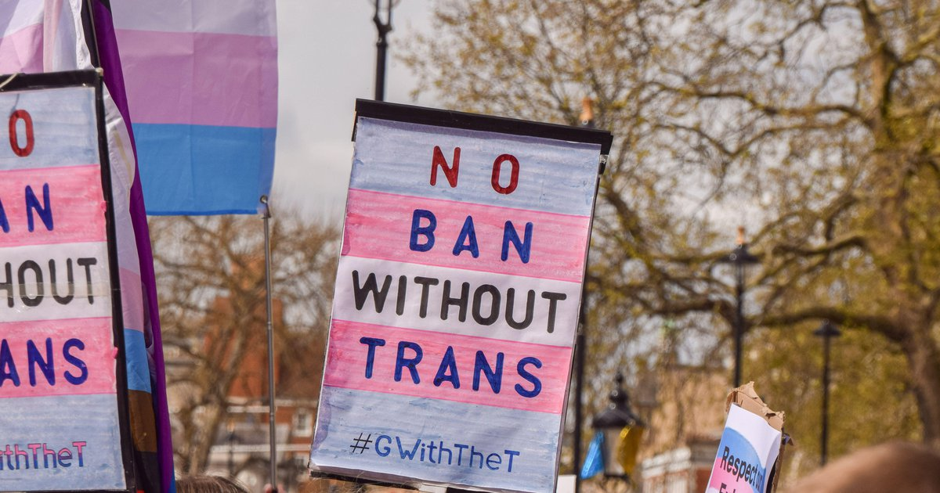
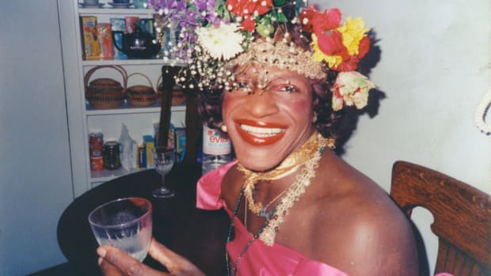
Not to forget

Slide 13
LGBTQ+ Health

Slide 14
‘Stigma, prejudice and discrimination create a hostile and stressful social environment

Slide 15
The minority stress model to explain how various factors may interact to explain the higher levels of psychological distress
According to the model, the stigmatising social context in which people live in increases the changes of psychological distress
This stigmatisation leads to frequent experiences of victimisation and prejudice which becomes a chronic stressor, in addition to the general life stressors that everybody faces
Meyer (2003)
The Minority Stress Model

Slide 16
LGBTQ+ experiences in health and social care
"People are not born homosexual or lesbian, it’s their CHOICE. The word of God the Holy Bible states clearly this is SIN! So does the Jewish Torah and the Islamic Qur’an” (Ben, Support Worker, Wales in Stonewall, 2015)
Twenty-four percent of patient-facing staff have heard colleagues make negative remarks about LGB people and twenty percent about trans people. Nine percent of health and social care staff are aware of colleagues experiencing discrimination or poor treatment because they are trans. Twenty-six percent of LGB staff have personally experienced bullying or poor treatment from colleagues in the last five years based on sexual orientation (Summerville, 2015).
Trans and non-binary people face many barriers to healthcare because of the reinforcement of the notion that gender is binary, and lack of knowledge or understanding in healthcare providers. This means that they face difficulties in accessing treatment and also face great disparities in health (Safer et al 2016; Vincent, 2019)
LGBTQ+ people may feel that lots of the information and advice they are given about or much of the support available, isn’t right for them. This may be because of their experiences and living arrangements
Some services may explicitly demonstrate a general understanding of LGBT culture whereas others may be seen or actually be outright hostile. Most services are framed within heterosexual assumptions (Cronin et al, 2011; Fish, 2006; Irwin, 2007).

Slide 17
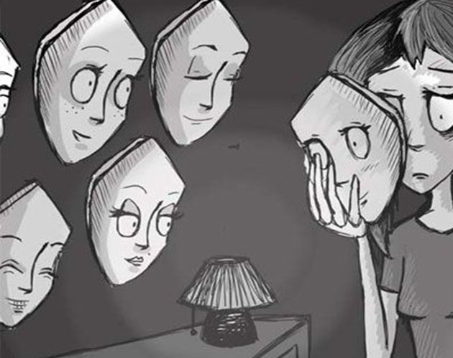
LGBTQ+ and cultural identity

Slide 18
To develop teaching and learning tools to be used by health and social care educators/trainers in order to improve their own knowledge and confidence in teaching LGBTQ+ issues;
To develop the knowledge of health and social care professionals on how to support LGBTQ+ patients and meet their health care needs;
To produce a best practice guides on how to develop an LGBTQ+ inclusive curriculum;
To prepare and pilot a Massive Open Online Course (MOOC) to support the participants in developing an awareness of LGBTQ+ needs in health and social care across Europe and the world.
The project aims to enable teacher/trainers of theory and practice to enhance their skills regarding LGBTQ+ issues and to develop teaching tools to support the inclusion of LGBTQ+ issues within health and social care curricula.

Slide 19
The partners
Notes:
Other project partners
Edunet, Romania
Cyprus University of Technology, Cyprus
University of Almeria, Spain
University of Southern Denmark, Denmark
University of Rome, La Sapienza, Italy
St. Augustinus Fachkliniken, Germany

Slide 20
Intellectual Outputs
IO1
IO2
IO3
IO4
IO5
IO6
Assessing the needs of teachers/trainers and learners for LGBTQ+ training
Internet Mapping and Systematic documentation of educational policies and guidelines as well as legislation at European and national level for LGBTQ+ inclusive education
Development of the curriculum and training model
Teaching/learning tools
Development of the modules for the MOOC content
The development, delivering, piloting and the building of the platform preparation of MOOC; also including the training of facilitator and evaluation
IO7
Evaluation strategy, methodology and best practice report

Slide 21
Needs assessment of teachers/trainers in terms of LGBTQ+ teaching and learning practice
PRINCIPAL AIMS
Understand the knowledge/skills, experiences and attitudes of health and social care teachers/trainers on LGBTQ+ subjects
Identification of teachers' and health and social care workers' LGBTQ+ learning needs and cross-cultural/country comparison.

Slide 22
4 Main Dimensions
1. Knowledge/skills
2. Positive and negative general attitudes
3. Experiences of discrimations and attended courses on LGBTQ+ themes
4. Needs
Training needs

Slide 23
Demographics
Type of work (academics vs workers)
2. Positive and negative general attitudes
4. Needs of
training on LGBTQ+ issues
3. Experiences of discrimations and attended courses on LGBTQ+ themes
Countries

Slide 24
Results
The sample included 412 health and social care academics (N=234) and workers (N= 178)
Results indicated that high training needs on LGBTQ+ issues were associated with low age, heterosexual sexual orientation, low awareness about LGBTQ+ issues and low number of courses on LGBTQ+ themes, high episodes of homophobic/transphobic discrimination, and compassionate attitudes.
Moreover, the needs for training on LGBTQ+ issues were higher for Cyprus, Romania, Spain, Italy, and UK, compared to Denmark.
Conversely, the training needs on LGBTQ+ issues were not associated with biological sex, type of work, years of working experiences, and negative attitudes towards sexual and gender minorities

Slide 25
Results
Key findings revealed that staff from Romania had more negative attitudes towards lesbian and gay people than all other countries.
Meanwhile, those from Germany and Romania were also less likely to know about homophobic or transphobic discrimination.
The highest number of incidents of witnessing discrimination towards people within the LGBTQ+ community was reported by participants from Cyprus and Italy. It was also highlighted that a need for training around LGBTQ+ issues was higher for Cyprus, Romania, Spain, Italy and the UK, compared with Denmark and Germany.
However, those from Germany and Denmark were less aware of LGBTQ+ issues and related terms than those from the UK and Spain. In addition, Romanian, German and Danish respondents reported attending fewer courses about LGBTQ+ than the other countries.
Findings also showed that Denmark (68%), Spain (67%), the UK (66%), and Germany (51%) had higher levels of respect of human rights, while other countries, such as Cyprus (31%), Italy (23%), and Romania (19%) were deemed as “less inclusive and supportive” of LGBTQ+ people, said the researchers within the study.

Slide 26
Culturally Competent and Compassionate LGBTQ+ Healthcare

Slide 27
Queering the health and social care curriculum

Slide 28
Queering the health and social
Poster/Lanyards, flags, intersexual identity LGBTQ+ youth of colour, older LGBTQ+
Role Modes
Mentoring and support – improve confidence of staff
Allyship
Co-production – listening to the voices of LGBTQ+ people
Challenging heteronormative systems and homo/bi/transphobia

Slide 29
“We have far more in common than that which divides us”
CULTURAL COMPETENCE

Slide 30
Finally…
Non ridere, non lugere, neque detestari, sed intelligere
(Baruch Spinoza)
Not to laugh, not to lament, not to curse,
but to understand!

Slide 31
Scan this QR code to visit www.iene-lgbt.com

Slide 32
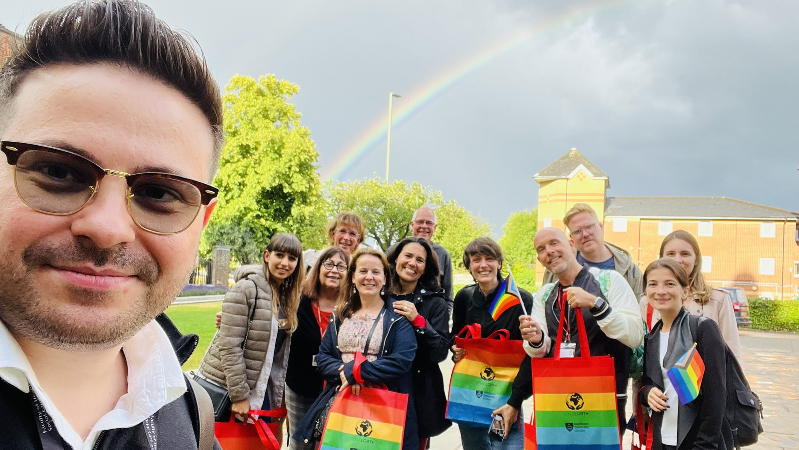

Slide 33
REFERECES
Bach, S. and Grant, A (2009) Communication & Interpersonal Skills for Nurses. Exeter: Learning Matters.
Elder, R, Evans, K. & Nizette, D. (2009) Psychiatric and Mental Health Nursing. Edinburgh: Mosby.
Ivliyeva, I. (2013) Intercultural Dimensions. http://sccen.mst.edu/gta/practicalteachingtips/effectivecommunicationinterculturaldimensions/
Papadopoulos, I. & Pezzella, A. (2015). A snapshot review of culturally competent compassion as addressed in selected mental health textbooks for undergraduate nursing students. Journal of Compassionate Health Care, 2 (3), 1-7.
Sully, P. and Dallas, J. (2010) Essential communication skills for Nursing and midwifery. 2nd edition. Edinburgh: Mosby Elsevier
CULTURAL COMPETENCE

Slide 34
References:
Pezzella, A., Pistella, J., Baiocco, R., Kouta, C., Rocamora-Perez, P., Nielsen, D., Kuckert-Wöstheinrich, A., Dudau, V. and Papadopoulos, I. (2021). IENE 9 Project: Developing a Culturally Competent and Compassionate LGBTQ+ Curriculum in Health and Social Care Education. Journal of Gay & Lesbian Mental Health.
Baiocco, R., Pezzella, A., Pistella, J., Kouta, C., Rousou, E., Rocamora Perez, P., López Liria, R., Dudau, V., Doru, A., Kuckert-Wöstheinrich, A., Ziegler, S., Nielsen, D., Twisttmann Bay, L., and Papadopoulos, I. (2021). LGBTQ+ Training Needs for Health and Social Care Professionals: A Cross-Cultural Comparison Among Seven European Countries. Sexuality Research and Social Policy. DOI: 10.1007/s13178-020-00521-2.
Carr, S. and Pezzella, A. (2017) Sickness, ‘sin’ and discrimination: Some contemporary challenges for UK mental health nursing practice with lesbian, gay and bisexual (LGB) people and communities. Journal of Psychiatric and Mental Health Nursing, 24(7), 553 560.
Davy, Z., Amsler, S., & Duncombe, K. (2015). Facilitating LGBT medical, health and social care content in higher education teach-ing. Qualitative Research in Education, 4(2), 134–163. https ://doi.org/10.17583 /qre.2015.1210.
Davy, Z., & Siriwardena, A. N. (2012). To be or not to be LGBT in Pri-mary Care: Health care for lesbian, gay, bisexual and transgender people. British Journal of General Practice, 62(602), 491–492. https ://doi.org/10.3399/bjgp1 2X654 731.

Slide 35
INTERNET RESOURCES
HTTPS://WWW.YOUTUBE.COM/WATCH?V=PST_OP3FQCK
HTTPS://WWW.YOUTUBE.COM/WATCH?V=LQQTOYSTME4
HTTPS://WWW.YOUTUBE.COM/WATCH?V=NVUU34KZDRG
When you listen to the above video replace the words “BUSINESS” with the word “HEALTHCARE”
CULTURAL COMPETENCE

Slide 36
Thank you for listening!
Any Questions?
Alfonso Pezzella, SFHEA, MBPsS
a.pezzella@mdx.ac.uk
@AlfPezzella
CULTURAL COMPETENCE

