Slide 1
Self Leadership
Daniela Collins
20/2/2020

Slide 2
Aims:
To define the concept of self-leadership and adaptive self-leadership and gain an understanding of leadership theories and styles
To be able to distinguish between self-leadership and self-management and consider what effective self-leadership looks like
To develop an awareness of your own strengths and leadership style and explore strategies to further develop your own potential as a leader.
_______________________________________________________________________________________________________________________
Before we look at self-leadership, we will define what leadership is and briefly review leadership models and styles
Notes:
Self-leadership is an important topic in today´s complex and dynamic work environment.
The aim of the webinar is to enable practitioners to gain an awareness of self-leadership and how to cultivate self-leadership aligned to your own values and the values of the social work profession.
We will consider why self-leadership is important in your personal and professional development as a social worker and what helps to shape your leadership style.
Self-leadership has been shown to result in greater career success and job satisfaction.
We will discuss what effective self-leadership looks like and how to grow your potential as a leader by effectively leading yourself

Slide 3
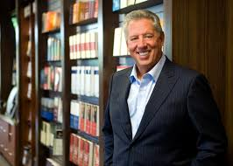
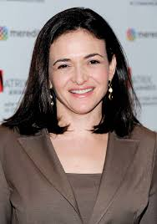
What is Leadership?
"A leader is one who knows the way,
goes the way and shows the way."
John Maxwell
“Leadership is about making others
better as a result of your presence
and making sure that impact
lasts in your absence.” - Sheryl Sandberg

Slide 4
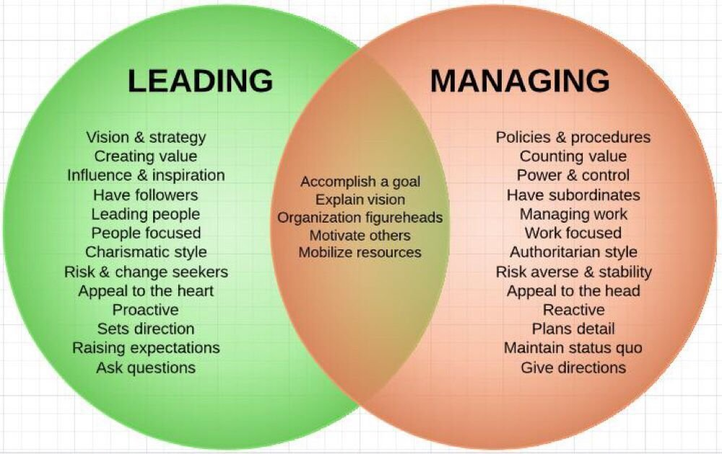
Management is doing things right, leadership is doing the right things (Drucker, 1999)
Leadership processes involve establishing direction, aligning people, motivating and inspiring
Management processes are concerned with planning, budgeting, organising, staffing, problem solving
Notes:
Any discussion about leadership and management has to recognise the importance of establishing a positive culture and how the quality of experiences for those working in public and community services is inevitably connected to how eﬀectively change is managed.

Slide 5
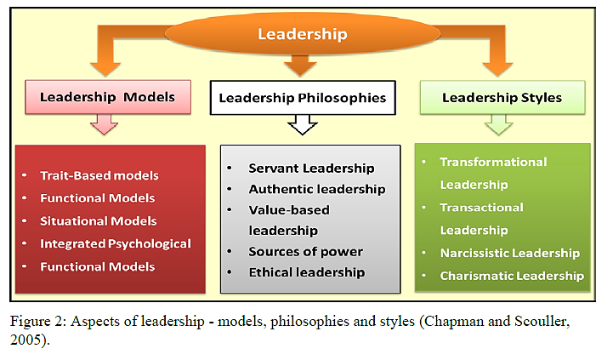
What Type of Person Makes a Good Leader?
the transformational leadership style, is often the most effective approach, it motivates people and build sstronger and more successful teams.
Notes:
The "transformational leadership" style, is often the most effective approach - it creates valuable and positive change in the followers with the end goal of developing followers into leaders.
Leadership Models
Carlyle & Gait an Trait Theory
Ral ph Stogdill Trait Theory
Kouzes & Posner Trait Theory
Douglas McGregor's XV Theory
Blake-Mouton's Managerial Grid
Kurl-Lowln's ThreeStyles Model
Bolm an & Ooal's Four Frame Model
Fiedler's Contingency Model
Her sey Blanchard's Situational Leadership® Model
Robert House's Path Goal Theory
Tannenbaum-Schmidt's Leadership Behaviour Continuum Model
John Adair's Actlon Centered Leadershi p Model
Kouzes & Posner Five Leader shi p Practices
James Scoullor's Three Levels of Leadership Model
Leadership Philosophies
Ser vant leadership
2. Authentic Leadership Ethical Leadership
Values--based leadership
F rench & R aven ' s Five Bases of Power
Leadership Styles
Bureaucr atic Leadership p
Charismatic Leadership
Narcissistic Leadership
Transformation Leadership & Transactional Leadership

Slide 6
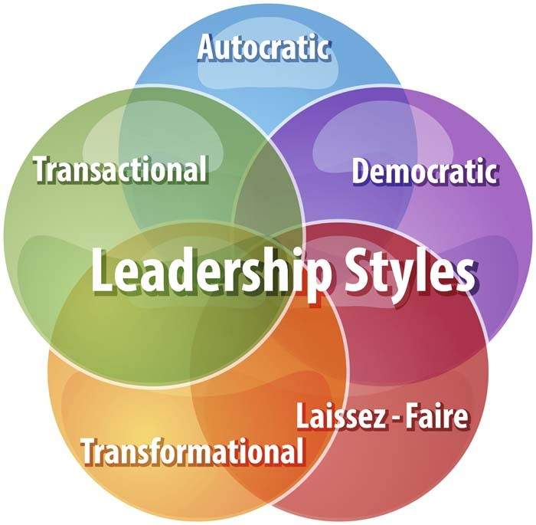
Leadership Styles
Focus of power
is with the manager
promote compliance
rewards and
punishments
Focus of power
is more with
the group
inspires people to
achieve remarkable results. It gives workers autonomy over specific jobs,
Laissez-faire
means to
“leave alone
Notes:
Authoritarian Leadership
Autocratic leaders hold onto as much power and decision-making as possible
Focus of power is with the manager
Communication is top-down & one-way
Formal systems of command & control
Minimal consultation
Use of rewards & penalties
Very little delegation
McGregor Theory X approach
Most likely to be used when subordinates are unskilled, not trusted and their ideas are not valued
Paternalistic Leadership
Leader decides what is best for employees
Links with Mayo – addressing employee needs
Akin to a parent/child relationship – where the leader is seen as a “father-figure”
Still little delegation
A softer form of authoritarian leadership, which often results in better employee motivation and lower staff turnover
Typical paternalistic leader explains the specific reason as to why he has taken certain actions
Democratic Leadership
Focus of power is more with the group as a whole
Leadership functions are shared within the group
Employees have greater involvement in decision-making – but potentially this slows-down decision-making
Emphasis on delegation and consultation – but the leader still has the final say
Perhaps the most popular leadership style because of the positive emotional connotations of acting democratically
A potential trade-off between speed of decision-making and better motivation and morale?
Likely to be most effective when used with skilled, free-thinking and experienced subordinates
Laissez-faire Leadership
Laissez-faire means to “leave alone”
Leader has little input into day-to-day decision-making
Conscious decision to delegate power
Managers / employees have freedom to do what they think is best
Often criticised for resulting in poor role definition for managers
Effective when staff are ready and willing to take on responsibility, they are motivated, and can be trusted to do their jobs
Importantly, laissez-faire is not the same as abdication
As a generalisation, in most business sectors there has been a gradual shift away from autocratic leadership. Possible reasons for this include:
Changes in society’s values
Better educated workforce
Focus on need for soft HR skills
Changing workplace organisation
Greater workplace legislation
Pressure for greater employee involvement
Which leadership style is most effective?
The answer, as so often in business, is that it depends on the circumstances.

Slide 7
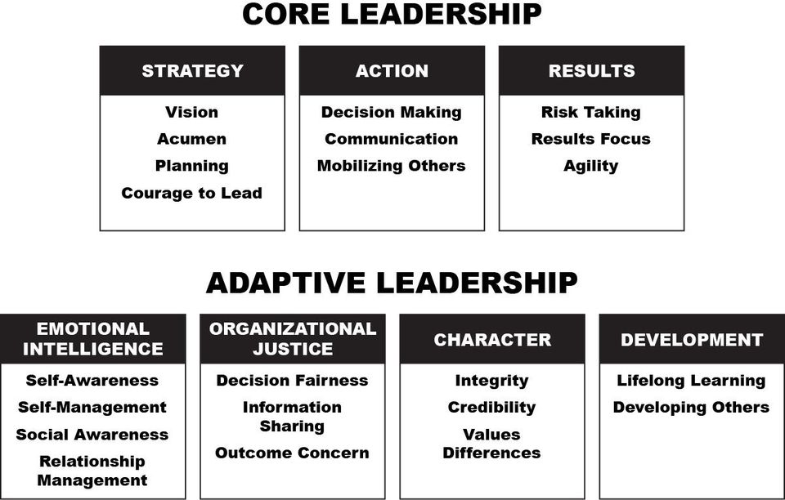
The core leadership skills are the foundation of effective leadership while the adaptive leadership skills create dynamic, agile leaders who are incredibly effective in any environment.
Bradberry (2009)
Notes:
Adaptive Leadership is...
Emotional Intelligence -Emotional intelligence is a set of skills that capture our awareness of our own emotions and the emotions of others and how we use this awareness to manage ourselves effectively and form quality relationships.
Organizational Justice - Great leaders don’t shy away from the truth. They know how to integrate what people think, what they want to hear, and how they want to hear it with the facts. This makes people feel respected and valued.
Character - Leaders who embody a true sense of character are transparent and forthcoming. They aren’t perfect, but they earn people’s respect by walking their talk.
Development - The moment leaders think they have nothing more to learn and have no obligation to help develop those they lead is the moment they ensure they’ll never know their true potential.
In addition to separating great leaders from the rest of the pack, adaptive leadership skills are what leaders overestimate their abilities in the most. We had leaders from a large cross section of industries rate themselves in all 22 core and adaptive leadership skills. We also had the leaders’ peers, boss(es), and direct reports answer the same questions about them, and we compared the scores. As the table that follows illustrates, the five skills in which leaders overestimate their abilities the most are all adaptive leadership skills.

Slide 8
What makes a good leader ? Five Characteristics of Emotional Intelligence (EQ)
Goleman’s (1995)
five characteristics
of emotional intelligence:
self-awareness
self-regulation
motivation
empathy and
social skill / relationship management
Notes:
Understanding the Five Categories of Emotional Intelligence (EQ)
1. Self-awareness. The ability to recognize an emotion as it “happens” is the key to your EQ. Developing self-awareness requires tuning in to your true feelings. If you evaluate your emotions, you can manage them. The major elements of self-awareness are:
Emotional awareness. Your ability to recognize your own emotions and their effects.
Self-confidence. Sureness about your self-worth and capabilities.
2. Self-regulation. You often have little control over when you experience emotions. You can, however, have some say in how long an emotion will last by using a number of techniques to alleviate negative emotions such as anger, anxiety or depression. A few of these techniques include recasting a situation in a more positive light, taking a long walk and meditation or prayer. Self-regulation involves
Self-control. Managing disruptive impulses.
Trustworthiness. Maintaining standards of honesty and integrity.
Conscientiousness. Taking responsibility for your own performance.
Adaptability. Handling change with flexibility.
Innovation. Being open to new ideas.
3. Motivation. To motivate yourself for any achievement requires clear goals and a positive attitude. Although you may have a predisposition to either a positive or a negative attitude, you can with effort and practice learn to think more positively. If you catch negative thoughts as they occur, you can reframe them in more positive terms — which will help you achieve your goals. Motivation is made up of:
Achievement drive. Your constant striving to improve or to meet a standard of excellence.
Commitment. Aligning with the goals of the group or organization.
Initiative. Readying yourself to act on opportunities.
Optimism. Pursuing goals persistently despite obstacles and setbacks.
4. Empathy. The ability to recognize how people feel is important to success in your life and career. The more skillful you are at discerning the feelings behind others’ signals the better you can control the signals you send them. An empathetic person excels at:
Service orientation. Anticipating, recognizing and meeting clients’ needs.
Developing others. Sensing what others need to progress and bolstering their abilities.
Leveraging diversity. Cultivating opportunities through diverse people.
Political awareness. Reading a group’s emotional currents and power relationships.
Understanding others. Discerning the feelings behind the needs and wants of others.
5. Social skills. The development of good interpersonal skills is tantamount to success in your life and career. In today’s always-connected world, everyone has immediate access to technical knowledge. Thus, “people skills” are even more important now because you must possess a high EQ to better understand, empathize and negotiate with others in a global economy. Among the most useful skills are:
Influence. Wielding effective persuasion tactics.
Communication. Sending clear messages.
Leadership. Inspiring and guiding groups and people.
Change catalyst. Initiating or managing change.
Conflict management. Understanding, negotiating and resolving disagreements.
Building bonds. Nurturing instrumental relationships.
Collaboration and cooperation. Working with others toward shared goals.
Team capabilities. Creating group synergy in pursuing collective goals.
Goleman developed a performance-based model of EQ to assess employee levels of emotional intelligence, as well as to identify areas of improvement. The model consists of five components, stated below.
1. Self-awareness
Individuals with high levels of emotional intelligence our comfortable with their own thoughts and emotions and understand how they impact on others. Understanding and accepting the way you feel is often the first step to overcoming it.
2. Self-regulation
It is also important to be able to control and manage your impulses and emotions. Acting rashly or without caution can lead to mistakes being made and can often damage relationships with clients or colleagues.
3. Internal Motivation
Being driven by only money or material rewards is not a beneficial characteristic, according to Goleman. A passion for what you do is far better for your emotional intelligence. This leads to sustained motivation, clear decision making and a better understating of the organisation’s aims.
4. Empathy
Not only must you understand your own emotions, but understanding and reacting to the emotions of others is also important. Identifying a certain mood or emotion from a colleague or client and reacting to it can go a long way in developing your relationship.
5. Social Skill
Social skills are more than just being friendly. Goleman describes them as “friendliness with a purpose”, meaning everyone is treated politely and with respect, yet healthy relationships are then also used for personal and organisational benefit.
Goleman argues that individuals that adopt these characteristics give themselves a far greater chance of being successful than individuals that do not. However, individuals are not simply born with these skills and they can be learned. They also work in synergy with each other and therefore developing each one of them has exponential returns. The author has also emphasised that cognitive and emotional intelligence are not opposing attitudes, but simply different disciplines that should be developed. He is certainly not suggesting cognitive intelligence is irrelevant, but that interest should be shifted to focus on them both equally.
In 2000 Goleman developed this model further, focusing on four key categories and various sub-categories within them. These categories are self-awareness, social awareness, self-management and relationship management.
Social skill is the ability to find common ground, build rapport, manage relationships and foster networks.
Goleman, Daniel. (1995). Emotional Intelligence. New York: Bantam Books, 1995. Print.
Goleman, Daniel. (1998). What Makes a Leader? Harvard Business Review, 1998. Print.
Goleman, Daniel. (2000). Working with Emotional Intelligence. New York: Bantam Books, 2000. Print.
Salovey, Peter, Marc A Brackett, and John D Mayer. (2004). Emotional Intelligence. Port Chester, N.Y.: Dude Pub., 2004. Print.

Slide 9
What does self leadership mean to you ?
’’He that would govern others first should be master of himself’’
Philip Massinger
Notes:
Self leadership can look different for all of us, it does not have to fit one exact definition, what being the leader of your life looks like for you maybe be different to what it looks like for me.
A Self leader is someone who takes full ownership of their life and choices;
Acknowledges fear without letting it hold them back; Deeply knows their core values and what they bring to the table; Choices to learn from their mistakes
uses their own intuition instead of always following others;
Knows the importance of caring for themselves
Lives life on their own terms and moves towards their dreams and purpose

Slide 10
Self Leadership
Great leadership starts with the person in the mirror. To lead others, we need to first be able to lead ourselves effectively. Even if you don’t have a leadership title within your organisation, you are still a self-leader.
Self leadership is the process by which
you influence yourself to achieve your goals
(Neck and Manz, 2010)
It is important to understand how others experience you in your leadership style so becoming aware of your own inner needs, strengths & areas for development (weaknesses) and to make adjustments is key.
Notes:
One of the best ways to foster innovation and performance is through autonomy.
Kanter defines leadership as “the art of mastering change and the ability to mobilise others’ efforts in new directions.
The most effective means of influencing people is through communication. A leader communicates to his or her followers a direction that they should move toward and tries to influence their attitude so that they will be ready to move in that direction. This requires vision on the part of a leader and the ability to guide people toward a common goal.

Slide 11
4 Pillars of Self Leadership
Your values
Notes:
Ladder of Self-Leadership

Slide 12
Align with your values to lead with authenticity
Values are stable constructs from which belief systems are generated & are central to motivation, behavior, relationships and happiness.
Most often values are unconscious and have been decided from an early age and are typically never re-evaluated, so we can end up with values that are not congruent with our current environment.
To effectively lead yourself, you need to be clear on who you are and what your core values are.
The rule of thumb is values can be expressed in 1 to 3 words. Beliefs need a full sentence. Attitudes need a paragraph.

Slide 13
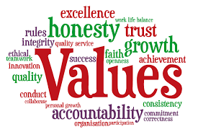
Align with your values to lead with authenticity
Self-leadership begins from a place of connectedness with your authentic self.
Values connect you to your authentic self and reveal who you are and what you stand for. If you were to identify your top 3 to 5 core values, what would they be?
Activity: To find out what your values are complete the exercise (Mind Tools website) https://www.mindtools.com/pages/article/newTED_85.htm

Slide 14
Self Awareness
Self-awareness is defined as knowing one’s self.
In order to develop self-awareness leaders must be willing to examine their own values, principles and assumptions, while also learning from their experiences.
The essence of an authentic leader is to be aware of yourself and how you interact with others and knowing who you are and the impact on other people. Self-awareness includes an understanding of your leadership style.
Notes:
One important skill for a Leader to continue growing is self-awareness. Self-awareness allows leaders to be conscious of their own strengths and weaknesses to develop plans for personal and professional development.
There are 4 types of Leadership awareness:
Known strengths,
Unknown strengths,
Known weaknesses
The Blind spots.
blind spots are the inner barriers you don’t see. They’re the stories you tell yourself that hold you back. Part of your role as a leader is to identify your blind spots

Slide 15
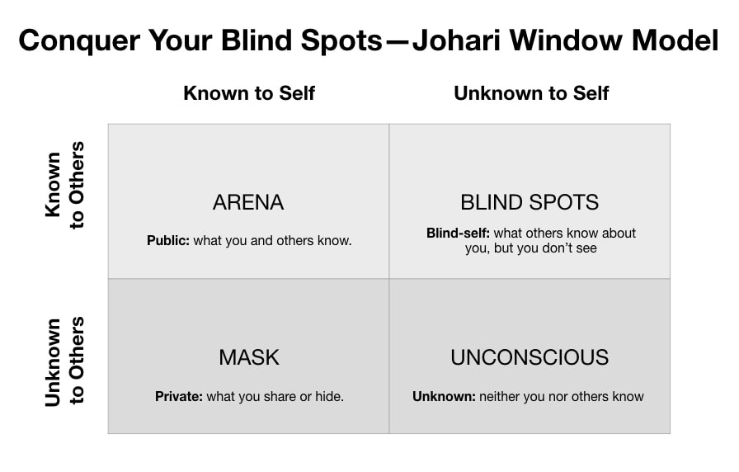
Become more self-aware
This area drives clarity
and builds trust.
not valuing your strengths
can also be a blind spot
Feedback is key
Notes:
Our blind spots lie at the intersection of how we perceive ourselves and how others perceive us.
The Johari Window was developed by Psychologists Joseph Luft and Harry Ingham to help us become more self-aware.
ARENA: Traits and behaviors that both yourself and others are aware of. It includes anything about yourself that you are willing to share. This area drives clarity and builds trust.
MASK: Aspects about yourself that you are aware of but might not want others to know. It can also include traits that you are not sharing with others without you being aware of. What you show to others is a mask that hides your authentic self as I wrote here.
BLIND SPOTS: What others perceive, but you don’t. Important to note: not valuing your strengths can also be a blind spot. Feedback from others can make you more aware of your negative traits but also of the positive ones you are not appreciating.
UNCONSCIOUS: What’s unknown to both you and anyone else.
Though this matrix has four quadrants, the size of each is not necessarily equal. Each window pane will vary depending on:
How much you share with other people
How well others (try to) know you
How well you know yourself

Slide 16
Awareness of your own strengths & leadership style
Consider the leadership styles you believe will best facilitate your goals
Effective leaders can adapt their style to the needs of their followers and to the nature of the situation. (Churchill, Lincoln - and others have been excellent leaders in difficult times but have been unsuccessful at other times).
Post session activity
Free online questionnaire from Mind Tools to discover your leadership style, learn about your strengths and weaknesses
of the way you like to lead
https://www.mindtools.com/pages/article/leadership-style-quiz.htm

Slide 17
5 core qualities of self-leadership
Enthusiasm for learning - Great self-leaders are learning enthusiasts & love to share new information.
Goals for life and career - how are you communicating and monitoring your own goal progress, outside of formal performance review?
Willingness to let go. Self leaders delegate and this allows for better leadership in areas of strength
Planning. Self leaders create plans & schedules and they stick to them
Focus and self-discipline. Focusing on one task at a time doing their best work and creating better results.
Self-leadership skills involve leaders’ abilities to reflect on self-strengths and weaknesses. Browning, M. (2018)
Notes:
Self-leaders have developed the skill of selecting what they want to focus on and tuning out the rest for a set amount of time.
This is even more critical when the task involves creating thinking or problem solving (rather than a rote task).

Slide 18
Good Self Leadership
Recognises and articulates your own values and principles, understanding how these may differ from other individuals and groups in an inclusive way.
Identifies your own strengths and limitations, the impact of their behavior on others, and the effect of stress on their own behaviour recognising and valuing diversity
Identifies your own emotions and prejudices and understands how these can affect judgment and behaviour
Actively seeks opportunities and challenges for personal development and acts on feedback from a variety of sources and changes behaviour based on feedback and reflection.
Notes:
In order to build and maintain successful relationships, leaders must be willing to listen, support others, gain trust and show understanding.
Skills alone are not enough for leadership.
We must have good values as well. Skills are not value free. Leaders must also have vision, and they pursue goals, which are expressions of values.
Pursuing skills and values for ourselves can be called Adaptive Self-Leadership, and pursuing them on our teams is Adaptive Leadership

Slide 19
Post session activity self assessment, feedback and reflection
Self assessment and reflection:
For the next 6 months observe your own leadership behaviour and keep a reflective journal. Ask yourself in each situation, if I could do that again, how I would do it?
Evaluate your effectiveness
Reflect on other’s reactions
Reflect on the results you obtained
Another way of getting to understand yourself as a leader is to ask for feedback
360 – degree feedback survey
Choose key stakeholders (‘blindspot buddy’) that you can meet regularly and receive honest feedback
Notes:
When asked about what he thought made him an exceptional leader, Mandela replied with a memorable story about his childhood.
He said that when he was younger, he would occasionally follow his father in community meetings. His father was the chief of the tribe and would always do the same thing when an issue arose - he'd listen to everyone's opinions before saying anything. I learnt that leaders speak last.
Exceptional leaders distinguish themselves because of superior self leadership (Goleman 2013)

Slide 20
5 tips investing in yourself to become a better leader
Self-care. is consciously built into everything you do throughout your day.
Self-awareness. knowing who we are & how we show up, what our strengths & weaknesses are, It’s the core of authenticity — and authenticity leads to trust.
Self-improvement. be on the lookout for ways to evolve.
Self-management. think about how you manage your thoughts and your feelings, both at work and at home. You can do this by journaling to be in touch with your emotions.
Self-reflection - The most successful leaders build self reflection into their lives.
Notes:
Self awareness - it doesn’t come easy and it’s a big blind spot for lots of people.
Everyone wants to grow, to stretch and learn, but our default is often to operate on autopilot.
Instead, let’s get comfortable with being uncomfortable. Look in the mirror, ask yourself the tough questions, and be honest with your answers. Ask yourself,
Am I the best that I can be?”
Once you get used to doing it, you’ll probably even start to enjoy the ritual. Self-leadership may not sound as fun as rosé and a bubble bath, but it’s certainly more rewarding! After all, if you don’t believe in yourself, no one else will.

Slide 21
Personal development plan

Slide 22
Personal leadership development plan
Use the SMART approach in creating your personal leadership development plan
Step 1: Define what makes a great leader; make a leadership skills list and what skills you wish to master?.
Step 2:Identify Your Core Values – see slide 12
Step 3:Write a Personal Vision Statement
Step 4: seek feedback from friends, colleagues, and family write down words they would use to describe you. see slide 15
Step 5: identify your critical indicators to success
Step 6:Find a Mentor
Step 7: Write action plan with measurable & time-bound Goals
Step 8. Reflect, Evaluate & seek development opportunities
Notes:
Today's most successful leaders are not the top-down authoritarians of the past; they are servant-leaders who foster meaningful relationships with those upon whom they depend and help elevate the performance and well being of those around them.

Slide 23
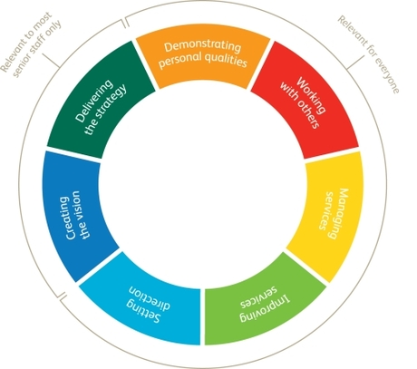
The Leadership Quality Framework (2014)
is grounded in everyday practice and behaviours and underpinned by personalisation and co-production
describes, in a clear and accessible way, what good leadership looks like in different settings and situations
illustrates the attitudes and behaviours needed for high quality leadership at every level of the sector
“We know that good social care can transform people’s lives. High quality leadership is fundamental to the delivery of good care.

Slide 24
LQF Six Principles of leadership practice
Social purpose
Co-production
Innovation
Improvement
Integration
Risk and responsibility.
The LQF (2014)
covers 4 levels of leadership
Front-line Worker,
Front-line Leaders,
Operational and
Strategic leaders.
https://www.adass.org.uk/AdassMedia/stories/Workforce_Development/NSASC_LeadershipStartsWithMeSpring13.pdf

Slide 25
Social Work Professional Capabilities Framework (PCF) refreshed with addended 3 “overarching principles” to guide all social workers in their practice. (BASW, 2018)
Post session activity: Reflect on your core motivations, values & ethics & how these affect your self leadership in your SW approach and practice
Notes:
The nine domains that make up the PCF help to explain what social workers do.
Social work involves complexity and needs to be viewed holistically.
Capabilities interact together to make up professional practice; they should not be viewed in isolation.

Slide 27
References
Browning, M. (2018) Self-Leadership: Why It Matters. International Journal of Business and Social Science Volume 9 no. 2 pp. 14-18.
Bradberry T. (2009) Emotional Intelligence 2.0. San Diego: Talent Smart
Goleman, Daniel. (1995). Emotional Intelligence. New York: Bantam Books, 1995. Print.
Neck, C. P., & Manz, C. C. (2010). Mastering self-leadership: Empowering yourself for personal excellence (5th ed.). Upper Saddle River, NJ: Pearson Prentice Hall.
Chapman, A and Scouller, J (2005) Leadership Theories; Business Balls. http://www.businessballs.com/leadership-theories.htm; Date accessed: 17.2.2020
BASW (2018) Guidance on using the 2018 refreshed PCF – BASW
https://www.basw.co.uk/system/files/resources/Detailed%20level%20descriptors%20for%20all%20domains%20wi%20digital%20aug8.pdf
DH (2014) LQF https://www.adass.org.uk/AdassMedia/stories/Workforce_Development/NSASC_LeadershipStartsWithMeSpring13.pdf

Slide 28
Additional resources:
Test your self-leadership How good are you in leading yourself?
9 questions instant result (no log in required)
https://larstummers.com/self-leadership-good-leading/
The questionnaire is based on
Houghton, J. D., & Neck, C. P. (2002). The revised self-leadership questionnaire: Testing a hierarchical factor structure for self-leadership. Journal of Managerial Psychology, 17(8), 672-691.

