Slide 1
UK Social Pedagogy in Action
Relationship based practice and the
Family Learning Intervention Programme
Robyn Kemp, FLIP Manager

Slide 2
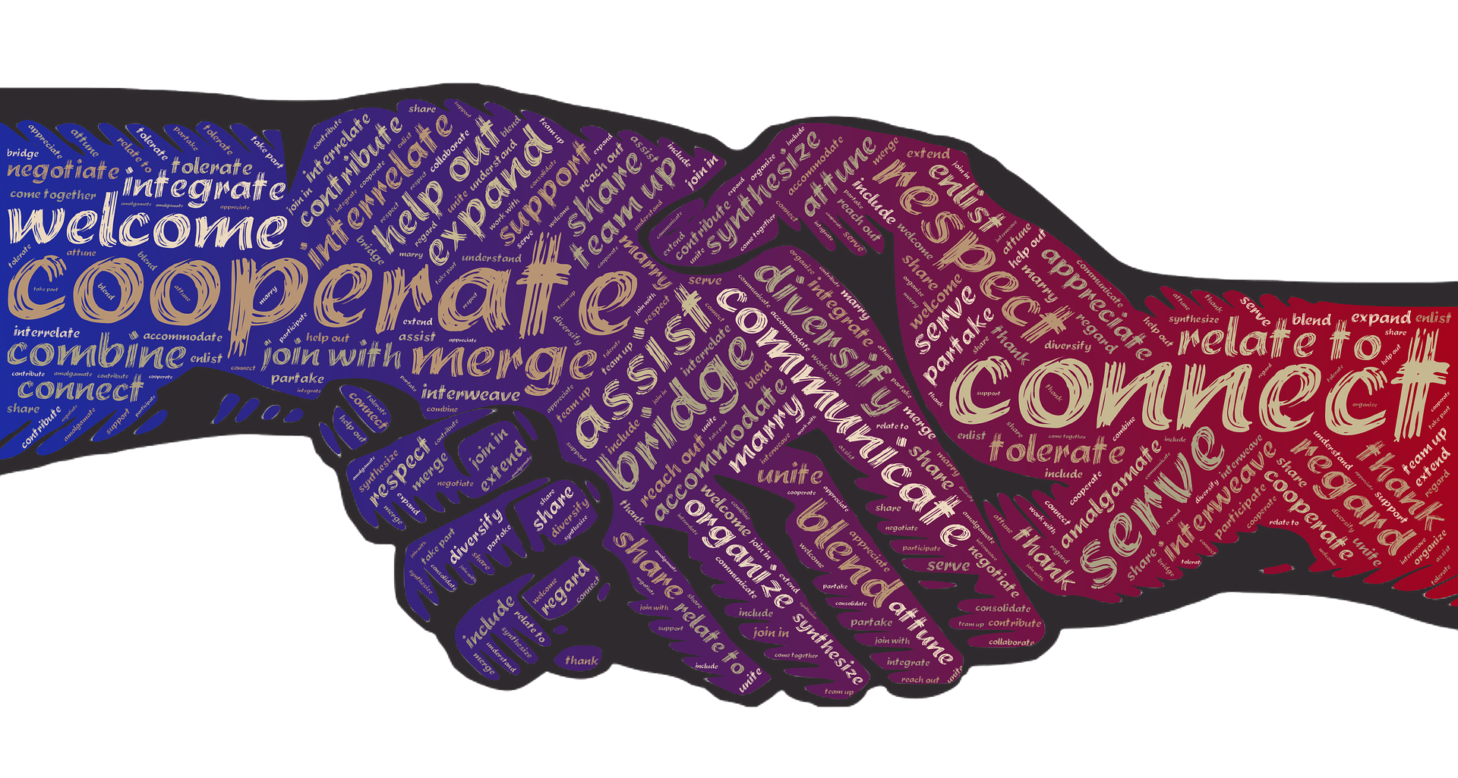
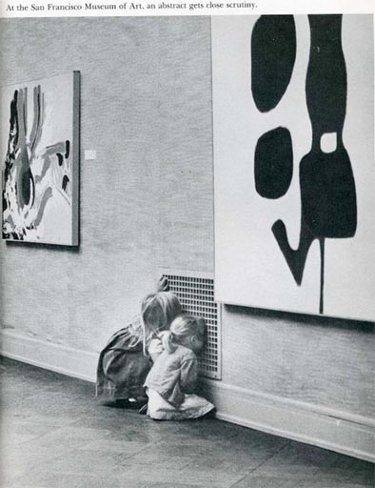
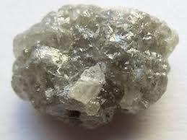
Social Pedagogy is many things…
Humane
Strengths based
Curious
Creative

Slide 3
HOLISTIC
HAND
S
HEAD
HEART
Notes:
Not only dealing with the head but also with the heart and hands - a holistic experience of empowerment, learning, relationships, wellbeing

Slide 4
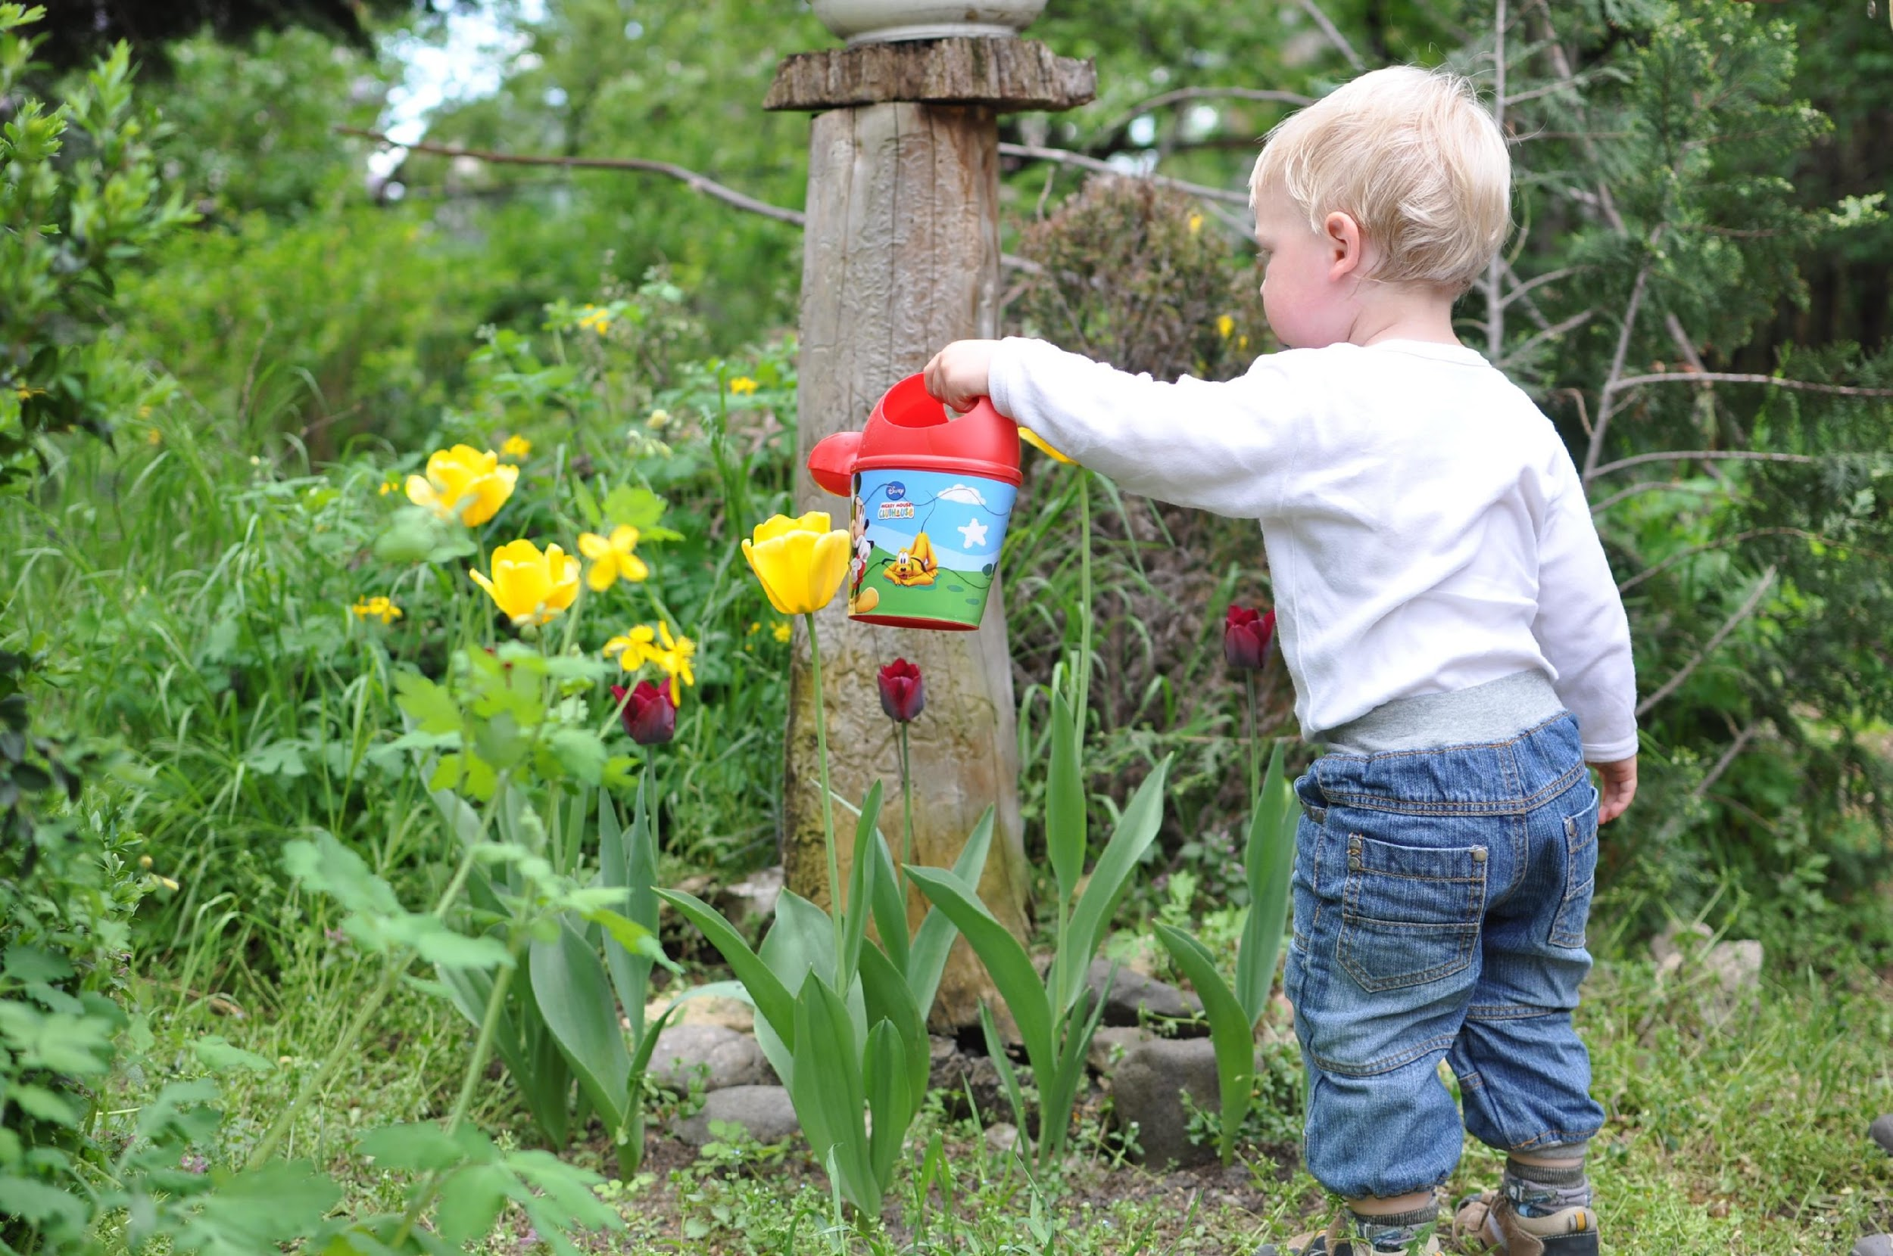
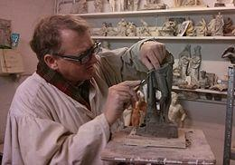
John Amos Comenius (1592—1670)
Not sculpting, but gardening
“The proper education of the young does not consist in stuffing their heads with a mass of words, sentences and ideas dragged together out of various authors, but in opening up their understanding to the outer world, so that a living stream may flow from their own minds, just as leaves, flowers and fruit spring from the bud on a tree.”
Notes:
Not sculpting, shaping children to our image of who they should be
Nurturing the environmental conditions surrounding children, for healthy growth, so that children can thrive
Many influences over time – Comenious was around before the age of enlightenment

Slide 5
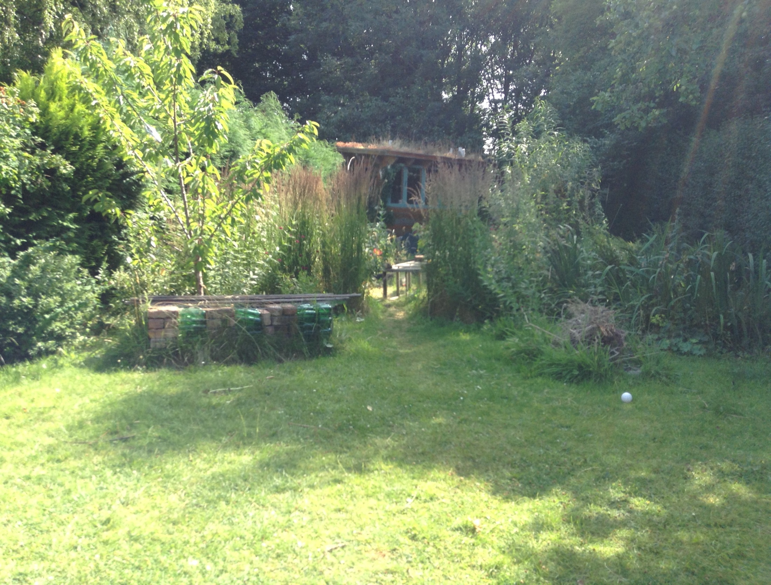
Paulo Freire (1921-1997)
Pedagogy as dialogue
‘…must abandon the educational goal of deposit-making and replace it with the posing of the problems of human beings in their relations with the world. "Problem-posing" education, responding to the essence of consciousness -intentionality - rejects communiqués and embodies communication’.
Notes:
Not the banking form of education…

Slide 6
The FLIP
Approach
where
how
why
what
who

Slide 7
Why FLIP?
Our purpose

Slide 8
AIMS
To help strengthen whole families – supporting long term family resilience
To address the gap between assessment and timely interventive support
To support better relationships within families and with the professionals supporting them
To prevent children and young people from coming into care
To prevent placement breakdown
To prevent children & young people from getting or being involved in gangs, child criminal exploitation and child sexual exploitation
To offer something ‘radically different’
More effective, timely support
to avoid separation & emotional harm

Slide 9
Where
Our contexts

Slide 10
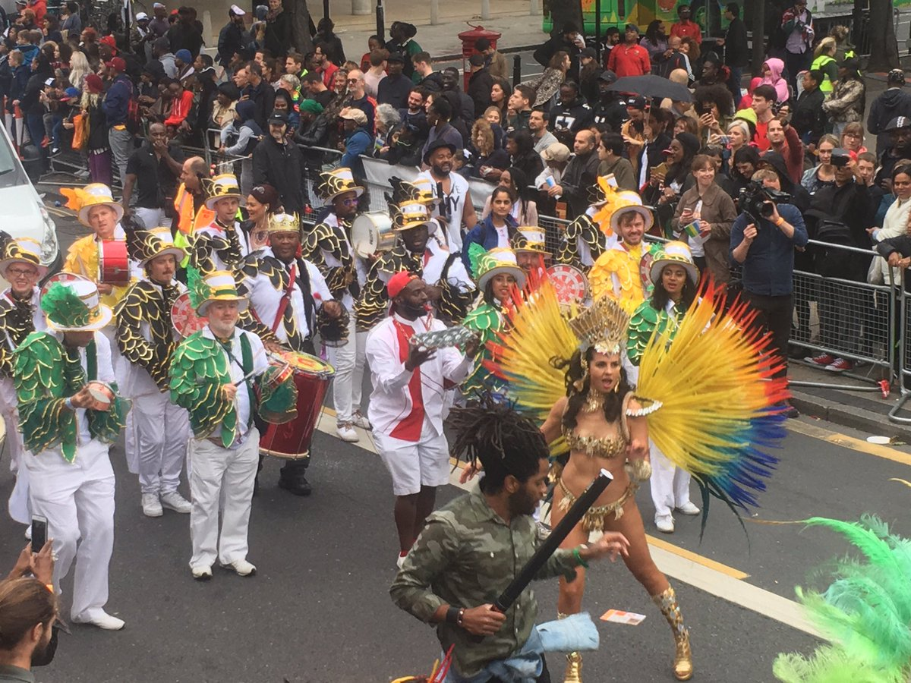
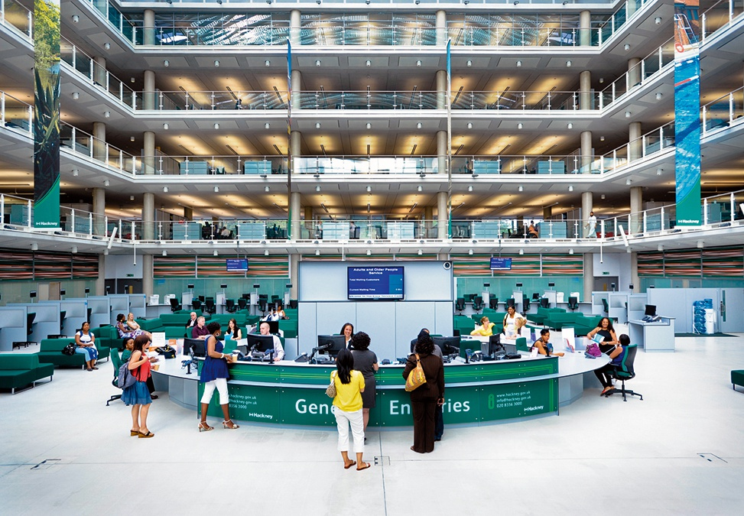
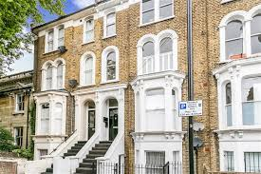
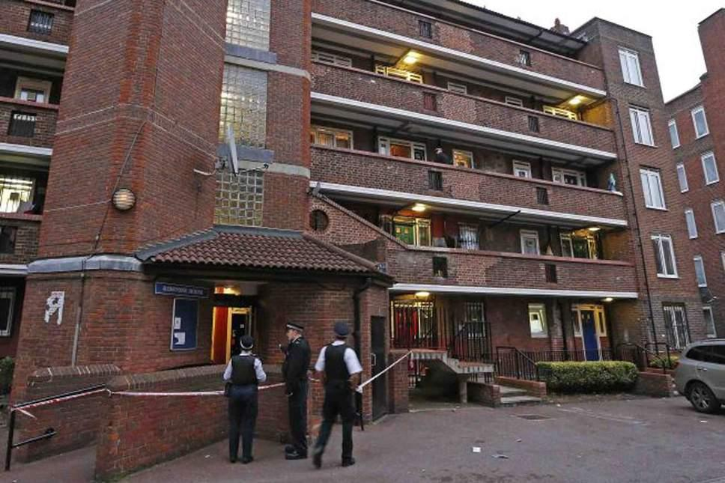
Notes:
I

Slide 11
Rural setting, 2 hours away from Hackney

Slide 12
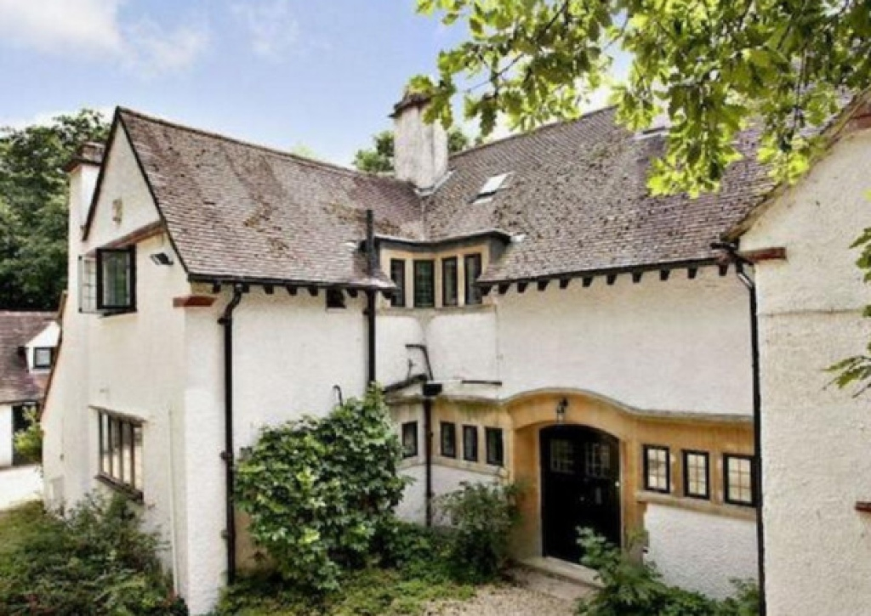
3-7 day residential experience for the whole family, social worker, FLIP team & other significant people for the family

Slide 13
What
We do

Slide 14
Family / Carers
Social Pedagogue & Oxford team
FLIP planning (6-8 weeks)
Social worker
Other important people
Notes:
Listen
Empathise
Hypothesise
Commit to hearing them all
Non violent communication
Good childhood questions
Parenting styles
Image of the child
Family culture, lifespace
Mentalisation

Slide 15
Creatively co construct an agreed plan for the week
09 - 13 October 2017 | Monday | Tuesday | Wednesday | Thursday | Friday
Staff AM | Social Worker, FLIP staff, professionals | Social Worker, FLIP staff, professionals | Social Worker, FLIP staff, professionals | Social Worker, FLIP staff, professionals | Social Worker, FLIP staff, professionals
Staff PM | Social Worker, FLIP staff, professionals | Social Worker, FLIP staff, professionals | Social Worker, FLIP staff, professionals | Social Worker, FLIP staff, professionals | Social Worker, FLIP staff, professionals
Time | What and who | What and who | What and who | What and who | What and who
7:30 AM | Wake up and Breakfast | Wake up & Breakfast | Wake up & Breakfast | Wake up and Breakfast | Wake up and Breakfast
8:30 AM
9:00 AM |  | School time | School time | School time | School time
9:30 AM
10:00 AM | Travel Time: Family and staff travelling to Oxford by train, arriving by 12 o'clock |  |  |  | Reflection, learning and moving forward planning
10:30 AM |  | What makes a good childhood? Parenting Styles | Session with clinician // Family puzzle | Non violent communication
11:00 AM
11:30 AM |  |  |  |  | Ending celebration
12:00 PM | Lunch | Break and pack for picknick |  | Break
12:30 PM |  | Activities Time: Farm Visit | Lunch
1:00 PM | Welcome to Silvertrees |  |  | Blindfolded obstacle course | Packing
1:30 PM
2:00 PM |  |  | Activities time: discussions, art projects, quizzes, writing, reflections |  | Leave at 2 o'clock
2:30 PM | Unpacking, settling in and relaxing |  |  |  | Family and staff travelling back to London by train
3:00 PM
3:30 PM |  |  |  | Mindful walk in the forest
4:00 PM |  | Family Time: Board games, play in the garden, discover the tree house | Break
4:30 PM | Activities time: Ice-breakers |  | 1:1 Social Worker and Young Person
5:00 PM |  |  |  | Dinner
5:30 PM |  |  |  | Activities time: Swimming
6:00 PM | Dinner | Dinner | Dinner
6:30 PM
7:00 PM
7:30 PM | Reflection and Learning | Reflection and Learning | Reflection and Learning
8:00 PM |  |  |  | Reflection and Learning
Overnight Staff | 2 staff | 2 staff | 2 staff | 2 staff

Slide 16
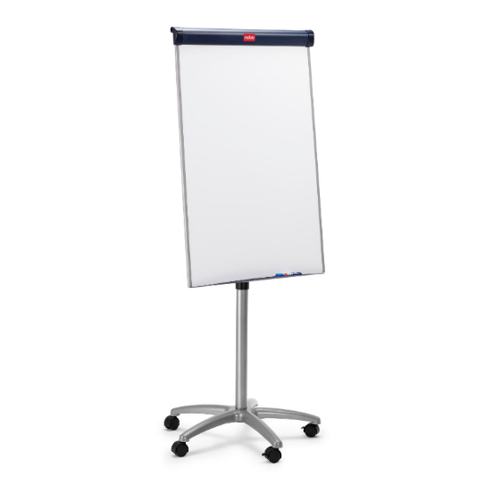
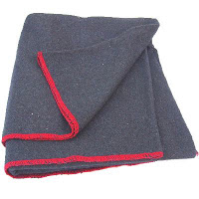
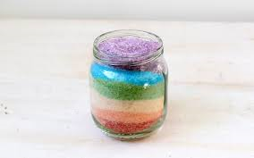
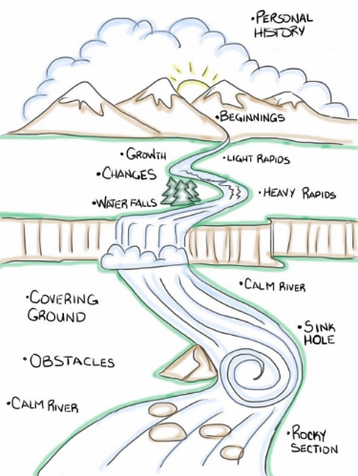
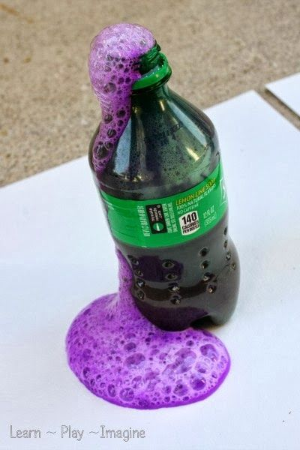
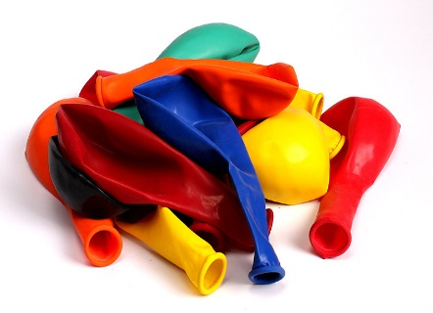
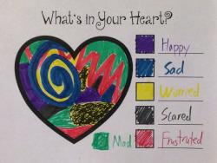
At Silvertrees

Slide 17
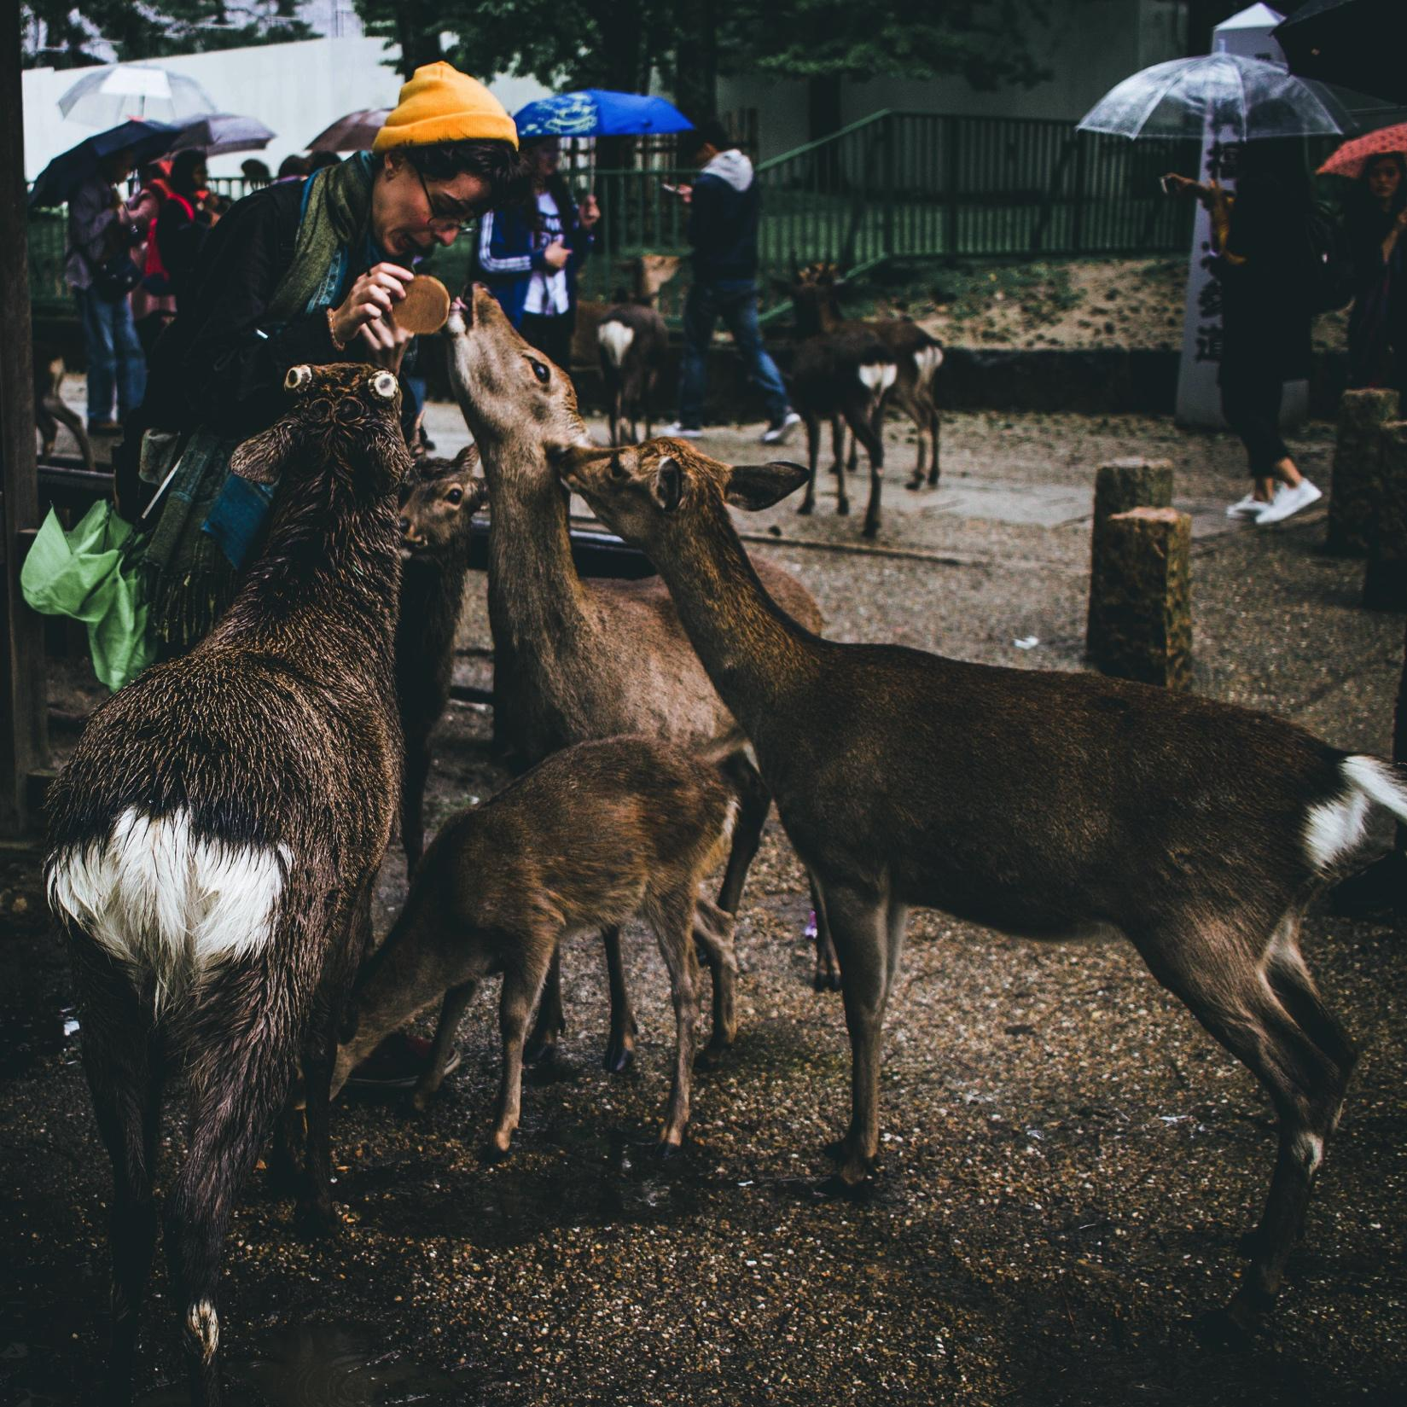
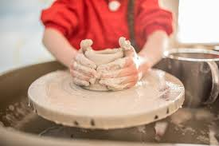
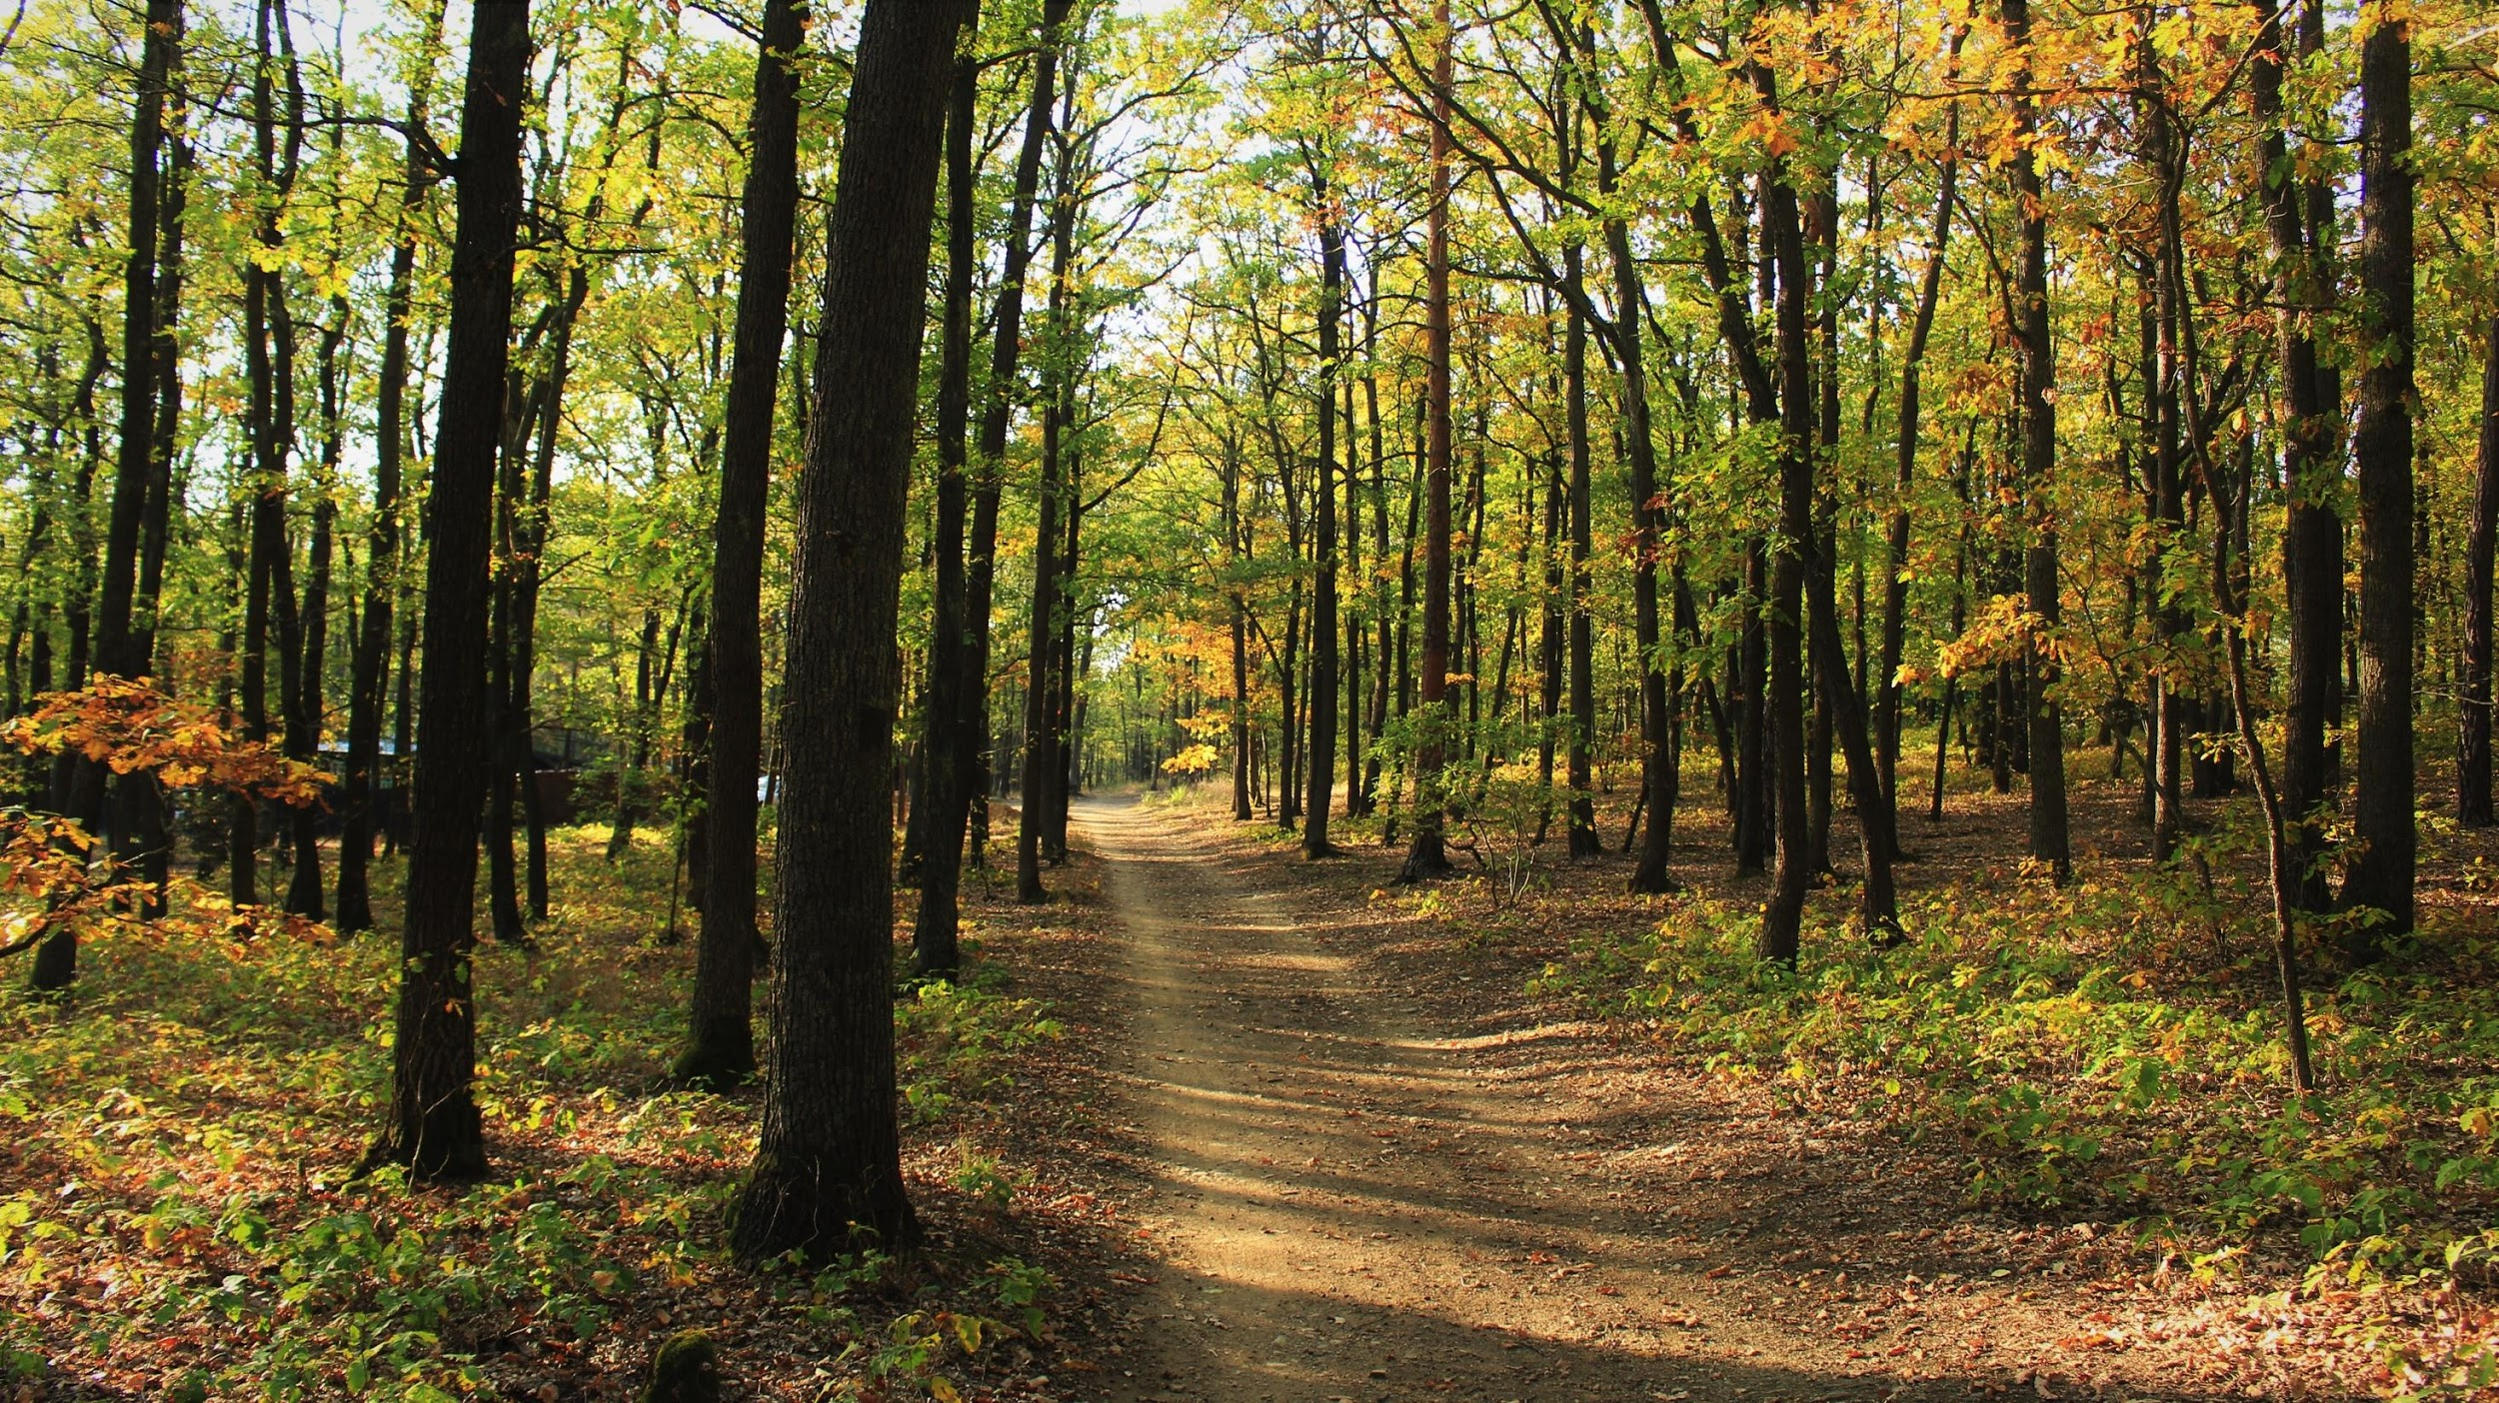
In the local area

Slide 18
How
Our approach

Slide 19
Non-manualised interventive family support
Rights
Kindness & Respect
Relation-ships
Playfulness
Collabor-ation
Value base
Creativity
Psycholog- ical safety
Learning
Reflection

Slide 20
Strong links between theory & practice
Non violent communication (Rosenberg)
Common Third
3Ps
Professional, Personal, Private
Learning Zone Model (Senninger, 2000)
Mentalisation (Fonagay; Ostergaard Hagelquist)

Slide 21
Post intervention support
Social worker remains the lead practitioner – intensive period of post FLIP support over the ensuing weeks
FLIP team facilitate professional and family debriefs after one week
FLIP staff return to review the plan and family’s progress after 1, 3 and 6 months as a minimum
Some families with specific needs return to review and build on their learning, and to revitalise their family strengths

Slide 22
Who
The people

Slide 23
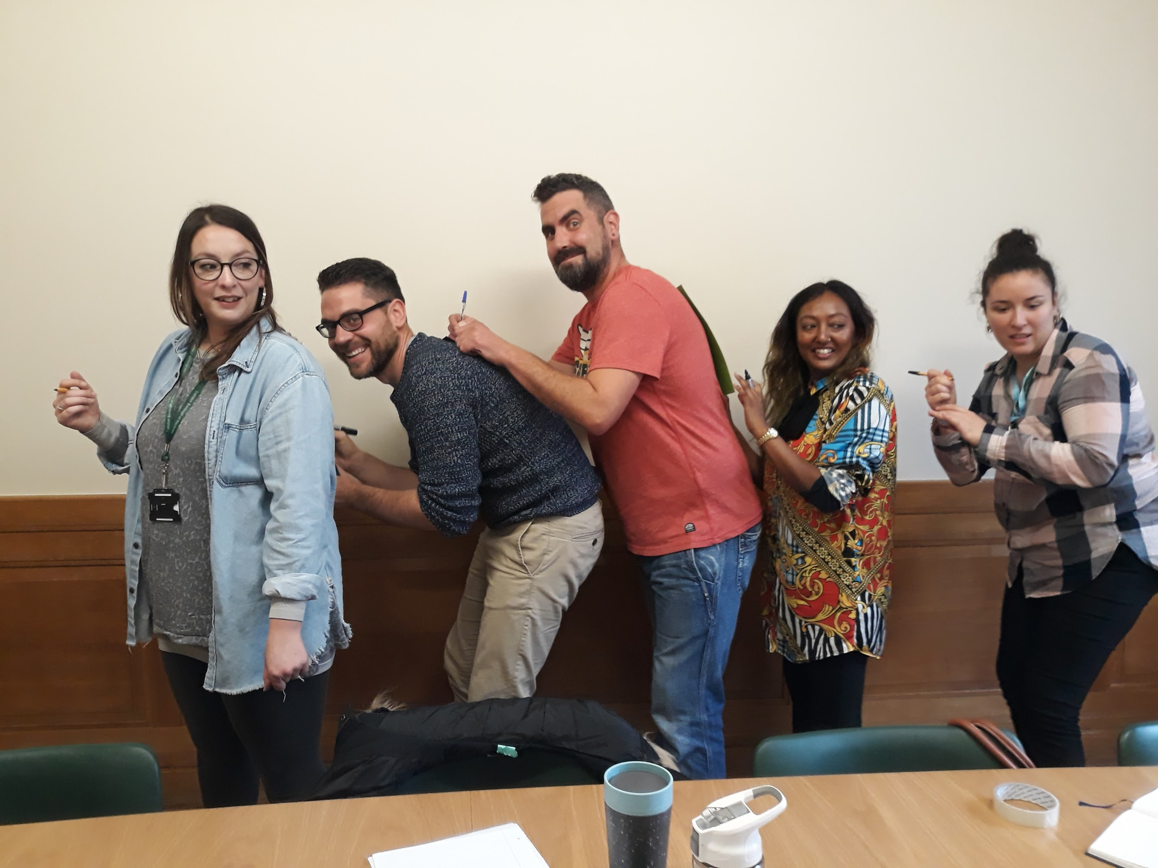
Children, young people & families
Children living with birth families – to strengthen family relationships and reduce risk of care
Children living with foster carers – to strengthen fostering and/or birth family relationships
Children living in residential care – to strengthen family and significant relationships
Wide range of family difficulties
Want to come and participate – free will
Co-create the plan, commit to meetings
Practitioners & Professions
FLIP team:
Social pedagogy; Youth work; Social work; Systemic family therapy; Substance misuse; Administration
Allied professionals:
Social workers; Youth Workers; Clinicians; Virtual School social pedagogues; teachers/teaching assistants; residential child care professionals; foster carers; supervising social workers;
Notes:
Parents struggling with children/young people’s behaviour ; children struggling to be heard; undiagnosed mental health; substance misuse;

Slide 24
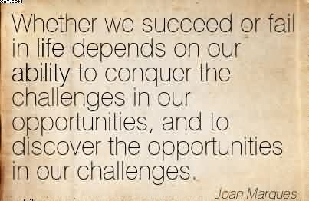
Some Challenges / Opportunities
Evidencing cost avoidance and value for money
Professionals eager to spend a week away from their own families with
Family fears that FLIP is a ‘boot camp’ or a way of ‘assessment by stealth’
Professional hopes that they can assess by stealth
Last minute changes and drop outs
Variations in understandings of how to work relationally
Collaboration
One team, two locations
Mix of professional disciplines
Long hours, taking breaks
Push (intra-familial) vs Pull (extra-familial) factors
Neighbours, discrimination, internet searches

Slide 25
Impacts & Outcomes
Planted and nurtured many seeds of change
Worked with over 70 families in our first 3 years
Helped to strengthen families to be together in a healthy way and enjoy each other again
Prevented foster and residential placement breakdowns
Supported young people to return to family from residential care
Kept the vast majority of families together
Massively reduced missing episodes
Helped to empower families to find their own solutions
Supported children & young people back into education
Improved relationships with help
Supported parents back into education and employment
Supported professionals to be less adversarial and more relational
Supported children have better relationships with birth families even though they remain in care
Not succeeded with every family
Performed no miracles…

Slide 26
Feedback
I just wanted to let you know that [the mother] was raving about how supported she has felt by services involved with [her children]. She seems like a different woman from when we began involvement and has felt really close to all of her children who are also really close with each other again – they spent Friday night as a family giggling together! She said that she feels valuable and worthy and that communication and respect between them has been much easier since FLIP. Clinical psychologist
“... if you can develop a safe and trusting relationship with a family, you are better placed to discuss difficult matters and challenge parents in more effective ways. That you can be a role model to the parents in regards to how you communicate and respond to the young person.” CIN SW
“(social worker) has become a new family member and we are not afraid of her anymore” Mother
“FLIP has a strong and knowledgeable team who supported and educated me prior to, during and after the intervention. They encouraged me to open up and explore different ways of thinking and helping to put context to the situation.” LAC Social Worker
“We seem to be more aware if our feelings and we also spend more time together” Father
“I took away that change can take time. I initially had thoughts of all issues being resolved, but through the intervention I am learning to be more patient and understanding that sometimes there is no quick fix and that trusting the process is important. It also highlighted the strength and importance of having a good team around a young person when a case is complex for sharing of ideas, thinking differently and general support.” LAC Social Worker
“I was very enriched by the experience not only to work with the family and understand things better but also it helped me to tune with myself, to be more empathetic, creative and loving of my job and colleagues, somethings we forget in the stressful environment of the office.” Supervising SW

Slide 27
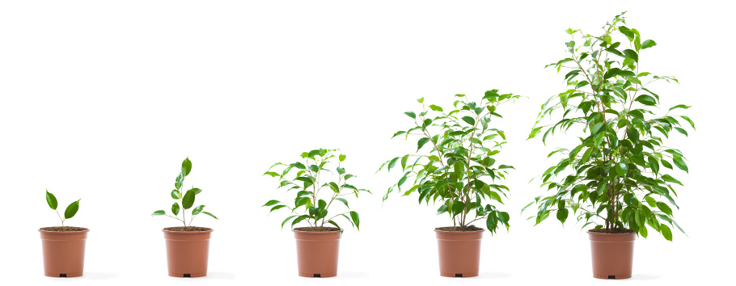
Thank you for listening!
Please do get in touch
Robyn.Kemp@hackney.gov.uk

Slide 28
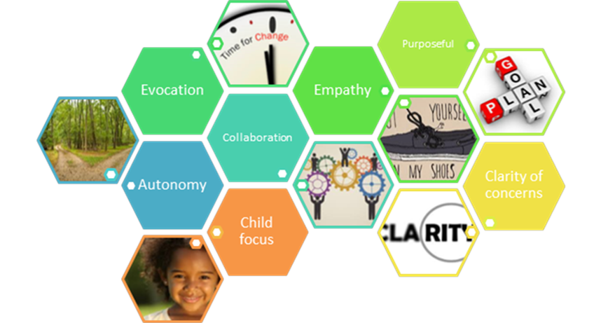
Islington Motivational Practice Model
Notes:
Application to children’s social car

Slide 29
Evolution of Islington and the University of Bedfordshire research partnership
Motivational Interviewing RCT
(CiN)
Islington Project Phase 1
(CiN)
Islington Project Phase 2
(CiN and CLA)
2012 2013 2014 2015 2016 2017 2018 2019
Does training in Motivational Interviewing (MI) impact on family engagement?
Development of MI framework to support practice development with coaching
Inclusion of trauma-informed practice
Notes:
Forrester
T1 observations
Coaching coding

Slide 30
Motivational Social Work A Practice Model
collaboration
evocation
purposefulness
Child focus
autonomy
empathy
clarity of concerns
Notes:
Build better relationships with parents through collaboration, empathy, evocation and autonomy, in order to have honest conversations about concerns which help the parent to take responsibility for changing their behaviour.
These seven behaviours are the best way we know of improving outcomes for children by improving the quality of parenting they receive…. Skills / behaviours that can be taught, practiced, observed, measured

Slide 31
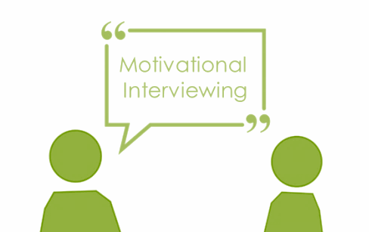
The Goal of Motivational Practice
Behave in a way that will reduce resistance and encourage someone to talk about reasons why change could be good
Notes:
Strength based model
Building relationships for change for children and their families

Slide 32
MI ‘Spirit’
Compassion
‘MI Spirit’
Partnership

Slide 33
The Four Processes in MI - Planning
4) Plan
3) Evoke
2) Focus
1) Engage

Slide 34
OARS -
OPEN QUESTIONS –
AFFIRMATIONS –
REFLECTIONS –
SUMMARIES -

Slide 35
The Language of Change
Sustain Talk
‘I hate being on a diet’
‘life’s too short to worry
about what you eat’
‘I’m too busy to exercise
Change Talk
‘I get out of breath so easily’
‘My kids moan at me to lose
weight’
‘I want to feel good in myself’

Slide 36
Development of the practice framework in CLA
Motivational Practice
CLA practice framework
DDP
Trauma Informed Practice
Notes:
Outcome of research from CIN… missing was need to enable practitioners to have greater understanding of developmental trauma… what stops parents changing even when they know they might lose their children?

Slide 37
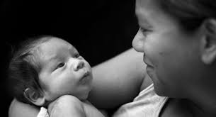
Attachment Theory: the building blocks of relationships
“This is me & you” (Internal Working Model)
Getting to grips with emotions (self-regulation)
Notes:
Link to Robyn’s presentation
Why relationship based practice

Slide 38
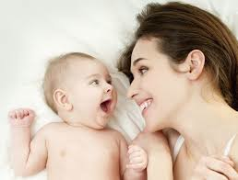
Attachment isn’t just the loving bond between parent and child; it is the relationship within which the infant experiences himself through the eyes of his carers; internalises a sense of self and other (Internal Working Model) and develops a capacity to regulate emotion. Security of attachment is achieved through “marked (slightly exaggerated) mirroring” of the infant’s emotional expression and through contingent i.e. attuned and sensitive responses to the infant’s needs and feelings so the infant feels “they got it… they understand me… I matter”
Notes:
Come into the world ready to attach and relate
Growing a brain
Experience becomes biology

Slide 39
Dads are important too!

Slide 40
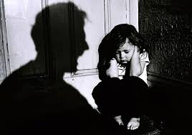
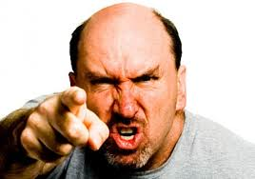
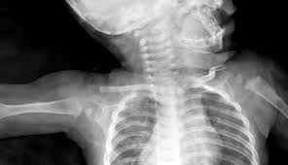
If parental responses don’t match the child’s needs or are inconsistent, insensitive, hostile or frightening, the infant will learn to adapt to survive but will struggle to develop a healthy ability to manage feelings and maintain a positive sense of self.

Slide 41
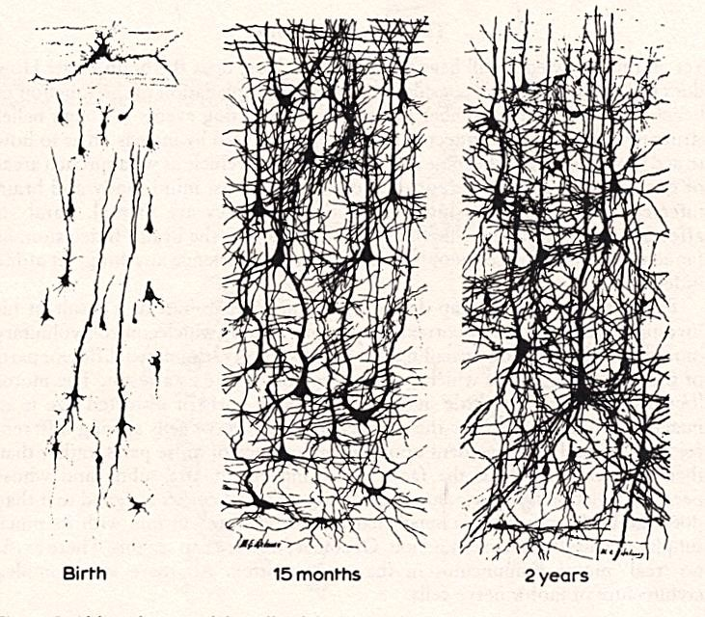
Growing a Brain
Birth.
15 months.
2 years.
Notes:
Experience becomes biology
All firing until age 2 then prune down… patterns of exerience... Predicatibilty... Patterns of response

Slide 42
Impact of stress, alcohol, DV etc. on foetal development
Evidence re high risk to under ones – shaken baby, NAI etc.
Parenting:
70% of parents don’t repeat cycles of abuse & neglect, 30% do (Crittenden, 2008)
Intergenerational cycles of neglect, abuse, loss and trauma
&
parental mental health difficulties, addiction and violence
Developmental trauma: attachment patterns; parents experienced as frightened / frightening
Adult relationships: repeating patterns: DV, addiction, mental health
Pre-school: early signs of aggression in nursery; speech & language delay; low capacity for self-regulation
Adolescence: behavioural challenges; offending; aggression as coping response to shame and trauma; depression; self harm
Middle childhood: poor peer relationships; underachieving at school; bullying / bullied
Notes:
Model written by C Rickman
Understanding of developmental trauma
Increased evidence base for what works and why
Brain science supports research

Slide 43
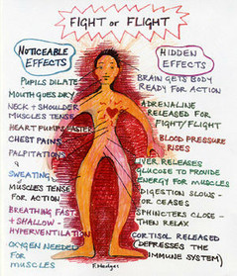
Notes:
Fight Flight Freeze

Slide 44
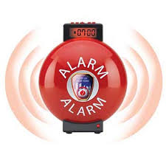
Trauma
Traumatic events have been described as those that "overwhelm the ordinary human adaptations to life [and] … generally involve threats to life or bodily integrity, or a close personal encounter with violence and death" (Herman, 1992, p. 33).
Immediate survival no sense of time / consequences
Amygdala response to perceived threat
Attachment
Physical integrity
Notes:
What happens when person you turn to for safety is frightening
Children are dependent… attachment more important than physical safety
Domestic abuse
Groomers work by forming attachments
Hippocampus... Time oriented filed memories
Trauma memories…. No control

Slide 45
ACE STUDY: Public Health Wales
ACE Study Wales Public Health
https://www.youtube.com/watch?v=XHgLYI9KZ-A

Slide 46
Wilson, Fauci, and Goodman’s (2015) analysis of contemporary approaches identified a set of principles and practices that are uniquely responsive to the lived experiences of trauma
Establishing emotional safety
Restoring choice and control
Facilitating connection
Supporting coping
Responding to identity and context
Notes:
Wilson, Fauci, and Goodman’s (2015) analysis of contemporary approaches identified a set of principles and practices that are uniquely responsive to the lived experiences of trauma:
an understanding of clients and their symptoms in relation to their overall life background, experiences and culture;
a focus on what has happened to a person rather than what is wrong with a person.

Slide 47
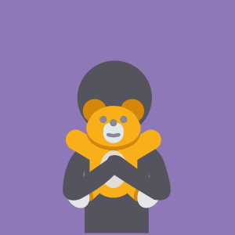
Dyadic Developmental Practice (DDP)
PACE – Playfulness, Acceptance, Curiosity and Empathy
Inter subjectivity – the joy in relationship, where children understand they have an impact on others and this behaviour elicits a response by the parent/carer
Connection before correction
Rupture & repair
Notes:
Intersubjectivity is about the brains neural connections being fed and nurtured by a consistent response from a caregiver in their early years
This affects how children learn and develop beliefs like ‘I am good and the world is a good place’.
There is now clear evidence that children who have been severely neglected can be healed and there is still potential for responsive carers to revive brain connections.

Slide 48
Practice framework- core skills
PRACTICE SKILLS
Relationship building
Collaboration
Child Focus
Empathy:
Acceptance
Curiosity
Demonstrating understanding
Respectful authority
Purposefulness
Clarity of issues
PRACTICE SKILLS

Slide 49
Practice Skills: Collaboration
“There are a few things I thought we could talk about today. One is we can talk about your mum and what is happening with her and her mental health. We can talk a little more about what it was like when you guys moved to London and what happened next, or we can talk more about what’s going on with you guys… is there anything you wanted to talk about?”
CLA
“A lot of that will be down to you, in terms of how you decide to manage it, if you think its right letting the girls have their own space.”
Fostering service
“What do you think you could try? What would help?”
Independent Futures
“Do you guys remember anything we spoke about before with your mum’s mental health?... What do we even mean by mental health?”
CLA
“What do you think you could have done differently?”
Independent Futures
“How do you think she interprets that?”
Fostering service

Slide 50
Empathy
Inside out
https://www.youtube.com/watch?v=QT6FdhKriB8

Slide 51
Practice Skills: Purposefulness
“I have a couple of things I want to talk to you about but first of all is there anything you wanted to talk to me about?”
CLA
“Do you guys have any thoughts on what we should talk about or would you like me to go first?”
CLA
“I just wanted to pick up on things we spoke about last week and go over the things that are on your mind”
Fostering service
“What else would you want to talk about because I’ve got things I want to talk about”
Independent Futures
“So just to recap you wanted to discuss…”
Independent Futures
“What would you like to talk about today?”
Independent Futures
“I’m hoping that I can help you talk through things that are on your mind to help you feel better about things and not stressed”
Fostering service
“I wanted to check in with you and see where everything is going”
Fostering service

Slide 52
Practice Skills: Clarity of issues
“Your mum lives in a place where there is support for her so people who can help with her mental health…but it has to be her choice in the same way that your counsellor at school can help you but only if you want. There are adults who are there to support her and I think you guys can try to trust they will do their best but I think your mum also needs to make a choice in accepting support. I think the best thing you can do and that will make her happy is to do your best to look after yourselves”
CLA
“What do you normally do when you’re here and the girls aren’t getting on, what are the things that are most affective in managing that?”
Fostering service
“I don’t always get to see where you live and that worries me sometimes if I’m honest”
Independent futures
“I worry that that’s the identity and narrative that she’s carrying around with herself.”
Fostering service
“What have you found difficult in the past couple of weeks?”
Fostering service

Slide 53
Practice Skills: Child Focus- CLA & IF
“I think that’s a really good question and you must think a lot about what you can do to help your mum”
CLA
“Maybe there is something about you are at an age where you are an adolescent and you are exploring different types of relationships. And maybe by playing or having fun you are exploring different type of relationships”
CLA
“You guys did really well in coming to the office on your own. I think I was pretty impressed by that. You showed commitment. You showed good organisational skills”
CLA
“From my point of view, I think it’s amazing what you’ve managed, the way you’ve managed it, and to keep a roof over your head with the payments and living away from your family, can’t be easy for any young person, but you’ve just got on with it. Which I think is amazing.”
Independent Futures
“I can see you’re smiling. I’m wondering what made you smile”
CLA

Slide 54
Practice Skills: Child Focus- Fostering service
“I wonder how Sarah took to her mum saying that you are her mum… that might be a little hard to hear.”
Fostering service
“She cries quite often because she misses mum”
Fostering service
“Is she prioritizing other people in trying to help them?”
Fostering service
“Where are you getting with Jane in terms of the other things that you’re finding difficult?”
Fostering service
“What do you think is happening to Laura? What would you guess that’s about?”
Fostering service
“What are the sort of things you have got her to work toward?”
Fostering service
“I wonder whether she was distracting herself… maybe carrying those feelings were not nice for her and were difficult and overwhelming”
Fostering service
“How do you think that she interprets that?”
Fostering service

Slide 55
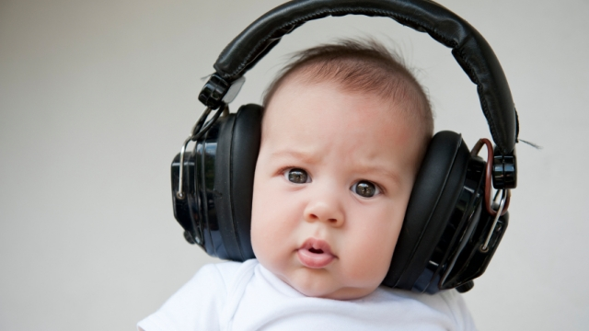
Analysing practice quality

Slide 56
About my practitioner
Word cloud generated from 14 answers to the question “Is there anything else you would like to say about your worker?”

Slide 57
Impact of the practice model so far – CLA
A young person has gained the motivation to apply for a new job
Slowly my engagement with the young person has improved
Accepting a young person’s feeling of anger/ badness. Has stopped me lecturing
More collaborative decision making, no shaming
Using DDP principles has already improved my conversations with a young person experiencing difficulty and build more trust between us
Young people feel more listened to and heard as well as that the sessions are led by them more

Slide 58
Impact of the practice model so far – Fostering
Helped Foster Carer to reflect on own experience of loss and how this impacts on responses to young person
Carers and young people appear more open and honest due to professionally we now able to show them that we are
Helping foster carers to have more empathy towards young person and be more accepting of difficulties and negative traumatic experiences of the young person
Foster carer's understanding of trauma and its impact on a foster child’s development has improved

Slide 59
Impact of the practice model so far – IF
A young person, long term NEET, is slowly getting into work and showing less episodes of aggression
The young people feel more listened to, valued and accepted, they are part of the decision making
Less challenging approach, more exploratory, more enables young person to reflect …to tell their story
Staff are really thinking about past trauma and how this affects future work with YP e.g. a young person was supported to visit their father’s grave
Some young people have opened up…they are able to plan their future goals

Slide 60
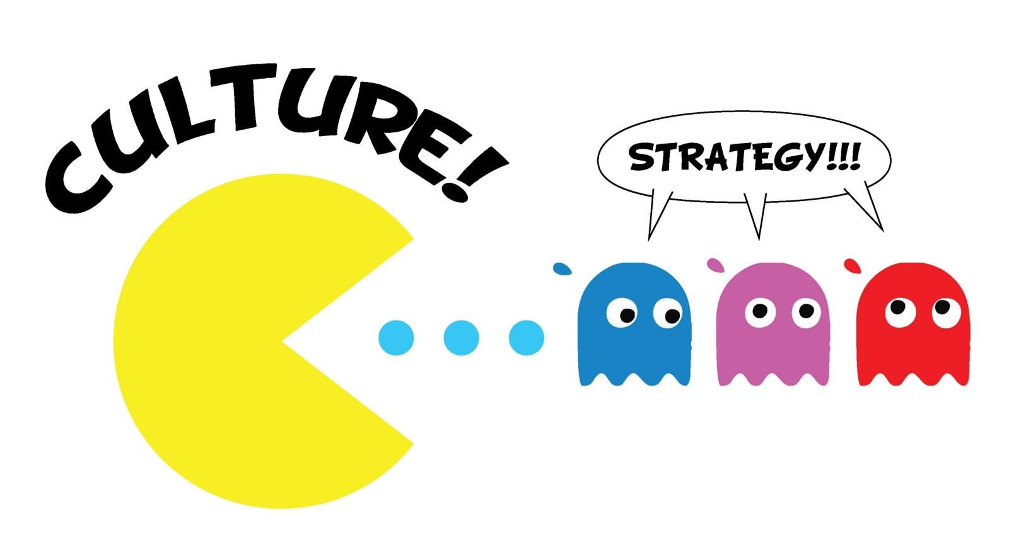
‘Culture Eats Training for Breakfast’ – Donald Forrester
This in mind …
Notes:
It was found that from the 1st wave measuring a SW skills through observations there was some decline several months after the initial training.
The way we found to combat this was to have an organisational cultural shift. Making changes across services and systems to accommodate new approach.
This is more likely to have a longer term impact.

Slide 61
Embedding the model & conditions for practice
Initial training – 3 day Motivational Interviewing core training
Observations/recordings and coaching
Champions
Reducing bureaucracy/Changes to recording system
Creating more time for direct work
Social Work Coordinators – freeing up time, a bit more understanding of the tasks
Thinking around Supervision of cases
Recruitment – role play
Notes:
Expand on coaching and feedback.
In the role play we expect practitioners to show potential skills linked the principles to then progress onto the 2nd stage.
Helping with interviews you get to see the difference between relational and directive practice.

Slide 62
The Future …
Practice Guides – already producing
Coaching Roll Out
DDP – Level 2
Group Supervision learning from CLA – to support CIN
Production of Videos
Beginning the transition to business as usual

