Slide 1
SCENTS OF SELF NEGLECT & HOARDING

Slide 2
A quick message from us…

Slide 3
Working with people who self neglect and hoard has a high impact on us as practitioners. We would like you to view this short video and think about how it might connect with your own experiences and feelings and how this might get under your skin. Which might be different from other experiences we have as practitioners.

Slide 4
Video 1

Slide 5
SCENTS OF SELF NEGLECT & HOARDING

Slide 6
DEFINITIONS
RESEARCH
PRACTICAL TOOLS
CHALLENGES
SUPERVISION
LAW & MCA

Slide 7
DEFINITIONS

Slide 9
Why self neglect
Research has shown that people who self-neglect have a five fold increase chance of death if self-neglect is not addressed.
We know that people may self neglect due to a variety of reasons, and as mentioned in the definition, it can be both unintentional or intentional.
Physical/Mental Health difficulties 6. Uncertainty about reasons
Homelessness 7. Loss & Social isolation
De-motivation 8. Trauma
Different standards 9. Skills – lack of

Slide 10
HOARDING

Slide 11
HOARDING DEFINITION
Hoarding is defined as the acquisition of and failure to disregard possessions that appear to be useless or of limited value
Stekette, G. & Frost (2014) Treatment for hoarding disorder therapist guide (2nd edn). New York: Oxford University Press

Slide 12
Hoarding
1/3 of people who die in house fires in the U.K are hoarding
Hoarding is recognised as a distant MH difficulty on its own (BPS 2015 / WHO)
Many people who hoard are isolated
Many people would have suffered a life trauma
It affects people of all ages and all demographics – starts around 11-15, get s worse with age
Affects both genders equally
More often unmarried 67%
More likely to be impaired by a physical health condition 52.6%
58% have comorbidities

Slide 13
Hoarding continued
Some research indicates that the behavioural tendencies to acquire and retain possessions can be seen as operating on a continuum from normal adaptive to excessive pathological.
Equally there is strong evidence that hoarding and collecting are separate and discrete activities. For example – In hoarding there is avoidance of discard, and unstructured and excessive acquisition across object categories. Whilst in collecting there is discard by trading to improve collection and themed and structured limited acquisition.
It can be the functional impairment and that some people who hoard have extreme functional impairment without significant distress (ego syntonic) where as other people feel significant shame and distress (ego dystonic). However they are still unable to make a decision to let go of belongings or possessions.

Slide 14
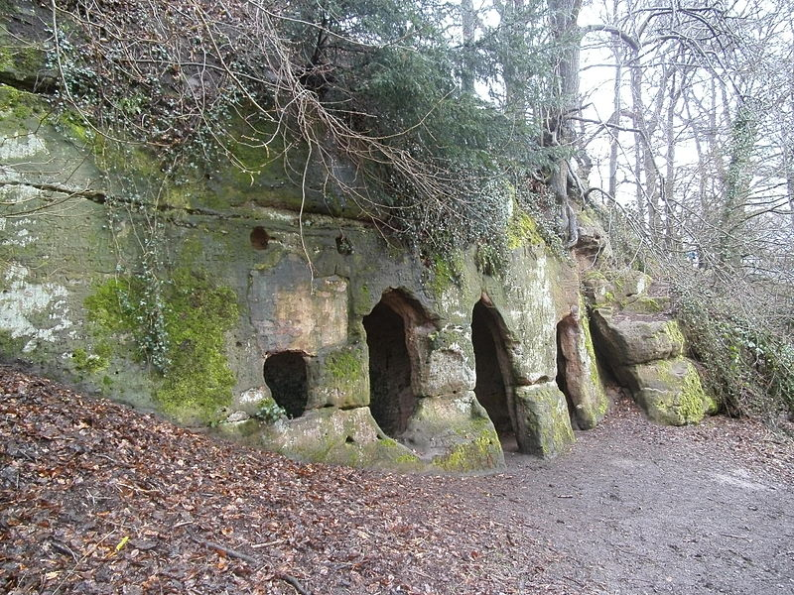
A central and crucial concept to be borne in mind with hoarding is that of Bion’s ‘container and contained’ (Bion, 1962a,b). The suggestion is that the absence of a containing psychic function leads to feelings of uncontainment, which in turn leads to psychic distress.

Slide 15
Video 2

Slide 16
Video 3

Slide 17
LETS TALK ABOUT SOME OF THE CHALLENGES

Slide 22
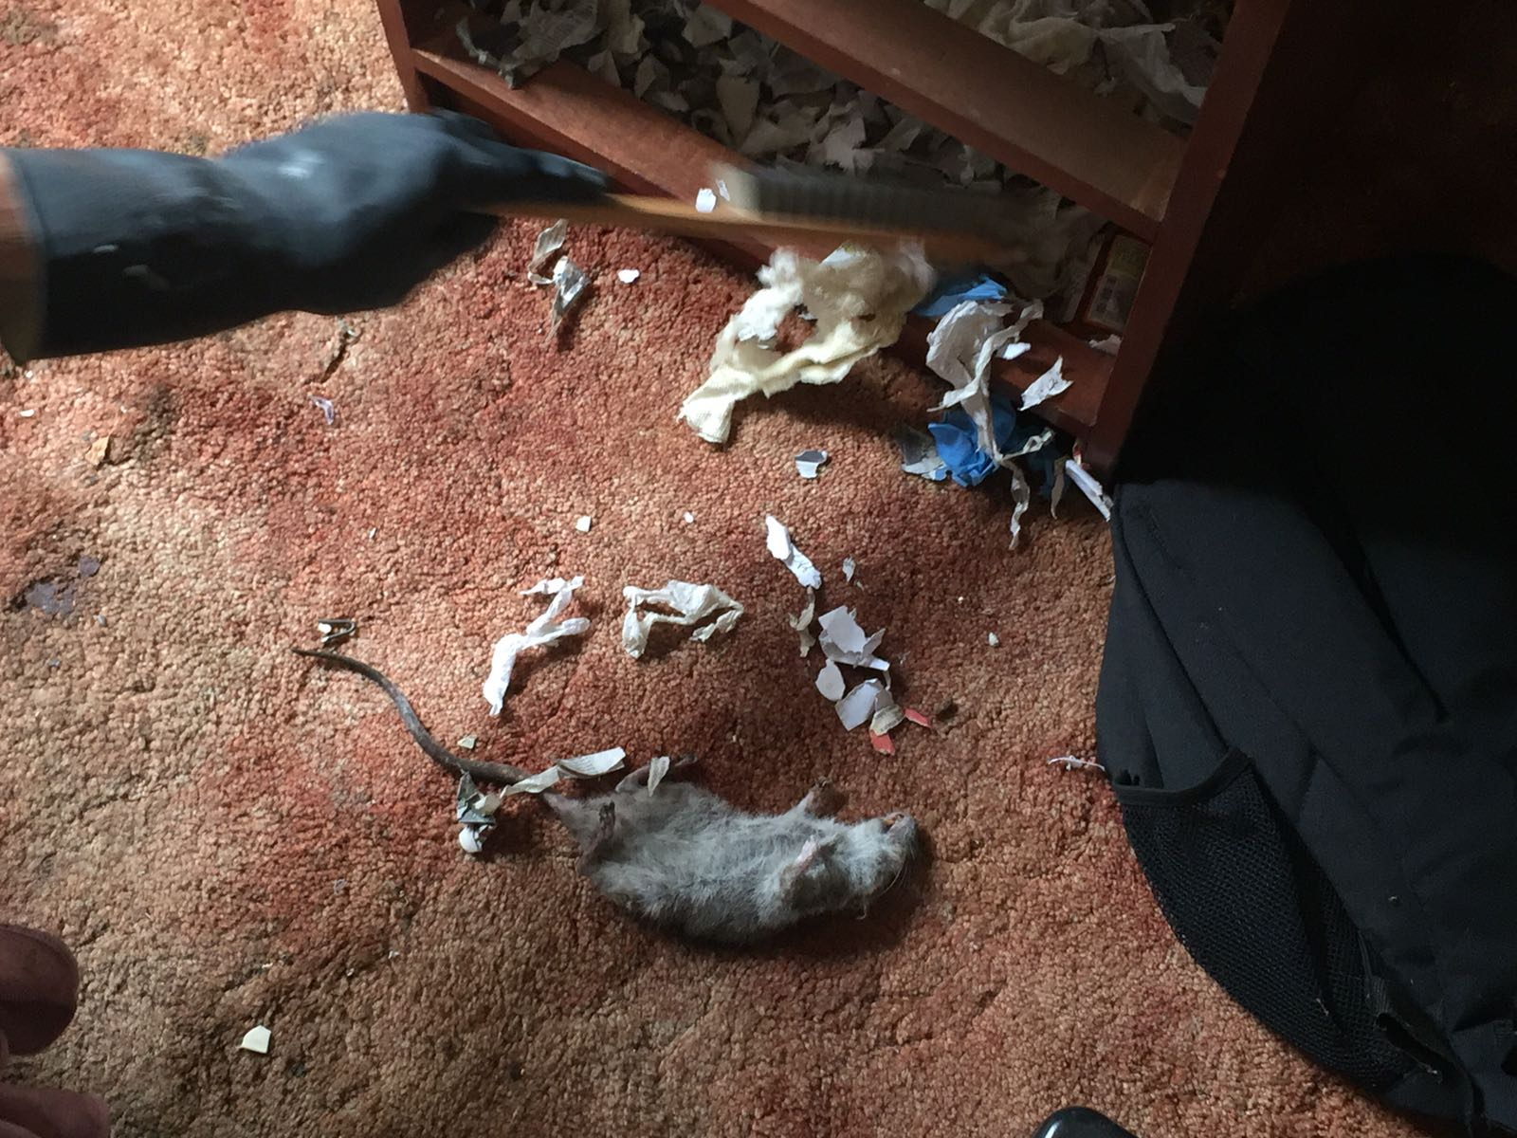

Slide 23
SAFETY

Slide 24
COMPLAINTS

Slide 25
DILEMMA
RELUCTANCE TO ENGAGE
ORGANISATIONAL PRESSURES

Slide 26
THE PERFECT STORM

Slide 27
REVOLVING DOOR

Slide 28
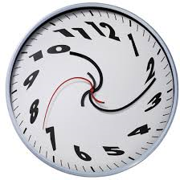

Slide 29
KNOWING
BEING
DOING

Slide 30
KNOWING

Slide 31
KIT KAT – please eat if you have one
2019
1937

Slide 32
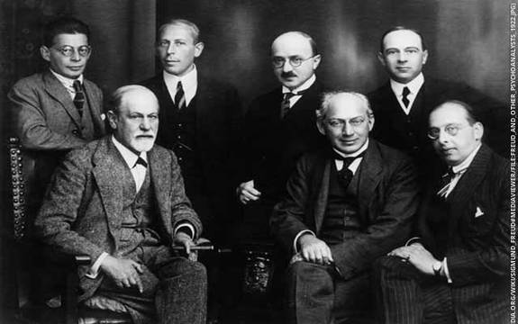

Slide 33
BEING

Slide 34
Video 4

Slide 35
STANDING STILL – also part of Being
Also a very important aspect in being is “being present alongside the person whilst trust is built”
Being silently creative
Recognising that this is a time that relationship and trust builds
Managers to recognise that this is also an important and active part of social work
Don’t rush to close case
Discuss in supervision
Don’t be alone with it

Slide 36
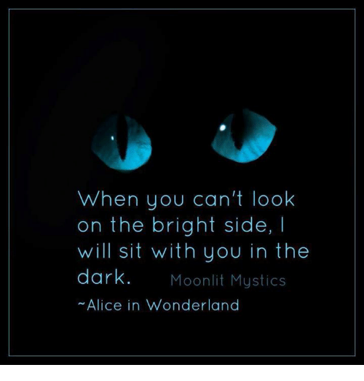

Slide 37
DOING

Slide 38
“DOING” THROUGH ONE MINUTE STORIES
HURRY-SLOWLY
ZONE OF TOLERANCE
HONESTY
WINDOWS OF OPPORTUNITIES

Slide 39
HURRY-SLOWLY

Slide 40
ZONE OF TOLERANCE

Slide 41
HONESTY

Slide 42
WINDOWS OF OPPORTUNITIES

Slide 43
what people who hoard / self neglect say they find helpful
Take the time to understand us.
Avoid making us feel defensive.
Focus on us as people, rather than just our problems.
Show a sense of timing - recognising when we might be ready to change.
Move at our pace.
Be careful to avoid body language or comments (for example “You’ve got a lot of stuff!”) which might seem judgemental.
Be honest about the possibility of imposed measures
Avoid presenting imposed measures as threats to get our compliance.
Find the balance between ‘encouragement’ and ‘pushiness’.

Slide 44
CARE ACT 2014 & Safeguarding
The care act 2014, updated 2016 includes self neglect as a category of harm
It places specific duties on LA in relation to self -neglect
Section 9 and 11 state that the local authority must undertake a needs assessment, even when the adult refuses, where it appears that the adult may have needs for care and support and is experiencing, or is at risk of self-neglect.
The duty applies whether the adult is making a capacitated or incapacitated refusal of assessment.
The care act places a duty of co-operation on the LA, police and health services
Principles of wellbeing
Duty of care / protect / prevent

Slide 45
Safeguarding
Section 42 – The LA must make, or cause to be made, whatever enquiries it thinks necessary to enable it to decide what action should be taken in an adults case when:
The LA has reasonable cause to suspect that an adult in it’s area:
has needs for care and support
is experiencing or is at risk of self-neglect and
as a result of those needs is unable to protect himself or herself against self-neglect, or the risk of it

Slide 46
LAW
Public health act 1936 EHO s83 and s84
Prevention of damage by pest act 1949
Environmental Protection Act 1990 s80 which is the provision for statutory nuisance
Building Act 1984 (various drainage repair provisions)
Public health and diseases act 1984 (Infection or contamination)
Police – Under anti social behaviour to prevent nuisance or annoyance (Anti-social behaviour crime and policing act 2014)
Police and criminal evidence act 1984 in emergency police can enter without warrant to save life and prevent injury or prevent serious damage to property
Housing Act 1985/1988 (Eviction on grounds of conduct or nuisance or annoyance)
Housing Act 2004 (Remedial action on building hazards)
Animal Welfare 2006 cruelty to animals a criminal offence
Mental Health Act 1983 authorising police / AMPH / Dr to enter premises. Application for admission for assessment (s2)and treatment (s 3)

Slide 47
Learning from SARS – Prof Michael Preston-Shoot
Too accepting of “lifestyle "choice & insufficient professional curiosity
Failure to escalate concerns to senior managers
Delays in raising safeguarding concerns or commencing Section42 enquiries
No agreed strategies to continue to engage
Poor record keeping of decision-making
Not involving family / network
Mental capacity and risk assessments insufficiently robust
Not sufficient account of persons feelings and wishes

Slide 48
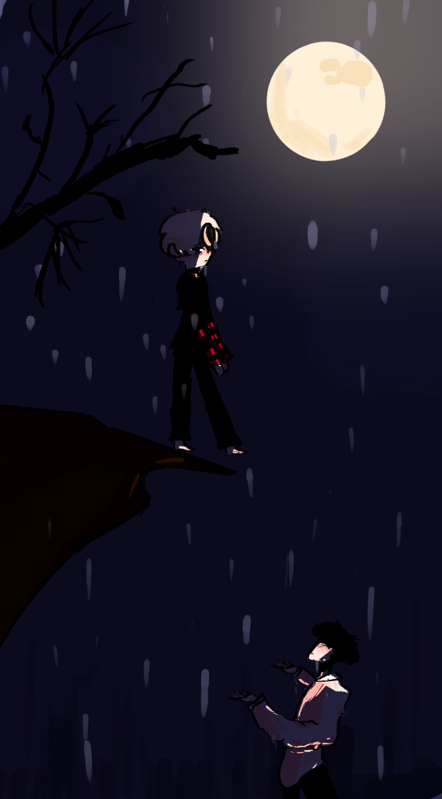

Slide 49
MENTAL CAPACITY Challenges
Information test / Impairment?
Human Rights Vs Duties under legislation and Human rights of others
Fluctuating capacity
Unwillingness to engage at all
Spoken word very strong
MCS vs MHA or MCA + MHA
People who have capacity and continue to put themselves in grave danger

Slide 50
MENTAL CAPACITY considerations
Behaviour, concerning conversations can pave way to completing information test. This is confirmed by The MCA code of practice which states that one of the reasons why people may question a person’s capacity to make a specific decision is ”the person’s behaviour or circumstances cause doubt as to whether they have capacity to make a decision” (4.35 MCA Code of Practice, P. 52)
Robust risk assessment
Timing of MCA (Delay or not to delay) / Delay Best interest action
Build relationship engage in the knowing, being and doing
Think about the How? (With another expert, relationships, context, advocate)
Executive Capacity - Case law – GW vs LA 2016
Decision and Questions / Debated topic

Slide 51
DECISION in ?
Does P possess the capacity for self care and self protection?
(Can P extract themselves from harmful situations and circumstances?)

Slide 52
MENTAL CAPACITY CONTINUED
If you are concerned about capacity but cannot get one done, then you can apply to the Court of protection
If the person is deemed to have capacity but is at risk of serious harm or death and refusing all services, or unduly influenced – Inherent Jurisdiction to the high court

Slide 53
MENTAL CAPACITY
“The presence of Mental Capacity should not be used as a justification for inaction”
“Honouring the wishes of a person with capacity demonstrates respect for the individual. Honouring the wishes of a person without capacity is a form of abandonment. The distinction, in so far as it can be reliably made is critical”.
Linda Farber-Post, clinical ethicist and educator

Slide 54
PRACTICAL TOOLS TO SUPPORT PRACTICE

Slide 55
Clutter rating tool

Slide 56
PHOTOGRAPHS

Slide 59
TEN DAY CHELLENGE
Day 1:
Day 2:
Day 3:
Day 4:
Day 5:
Day 6:
Day 7:
Day 8:
Day 9:
Day 10:

Slide 60
MINIMALIST
A DOCUMENTARY ABOUT IMPORTANT THINGS ON NETFLEX AND ALSO ON YOU TUBE
STRENGTH BASED EMPHASIS ON IMAGINING A LIFE WITH LESS, UNENCUMBERED BY THE TRAPPINGS OF A CHAOTIC WORLD AROUND YOU, A SIMPLE INTENTIONAL LIFE
TAKE PHOTOS INSTEAD
ADD VALUE BY DONATING ITEMS
BE DELIBERET IN OUR DECISIONS
THINKING THAT MEMORIES ARE IN US AND NOT IN THINGS

Slide 61
RECOVERY COLLEGE

Slide 62
MDT WORKING / PROFESSIONALS MEETING / HIGH RISK PANELS

Slide 63
SUPERVISION

Slide 64
Unresolved, unexplored emotion is like the magma inside a volcano – when it erupts a tsunami is unleashed”. (Shabnam Ahmed)

Slide 65
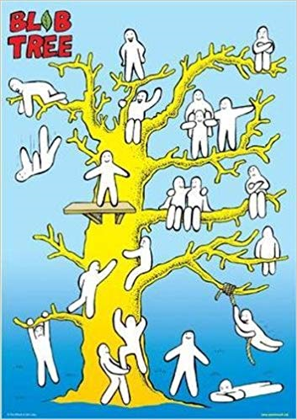

Slide 66
Showing your workings

Slide 67
GOOD DECISION MAKING KEMSHALL (2003) ON DEFENSIBLE DECISION MAKING
Did you act reasonably to gather and appraise and apply relevant information.
All reasonable steps are taken.
Reliable assessment methods are used.
Information is collected and thoroughly evaluated.
Decisions are recorded and carried through.
Agency processes are procedures are followed.
Practitioners and managers are investigative and proactive.

Slide 68
SHABS -SELF NEGLECT tool
BACKGROUND & AREA/S OF SELF NEGLECT
EVIDENCE OF SELF NEGLECT
ANALYSIS & POSSIBLE IMPACT OF SELF NEGLECT
PERSONS VIEW OF RISKS / RESPECTFUL ENQUIRY
CAPACITY?
HISTORY / FINDING THE PERSON
DISCUSS TRANSPARENTLY THE POSSIBLE IMPACT
CONSIDER THE STRENGTHS / PROTECTIVE FACTORS
DETERMINE ZONE OF TOLERNACE / MOTIVATION FOR CHANGE

Slide 69
SELF NEGLECT TOOL CONTINUED
WHO ELSE TO INVOLVE / MDT /HOUSING
SEEK LEGAL ADVICE AND MINDFUL OF USING THE PATHWAY
DISCUSS IN SUPERVISION
UP TO DATE AND ROBUST RECORDING
ALERTING ALL APPROPRIATE OTHERS WHO CAN BE THE EYES AND EARS
LEAVING THE DOOR OPEN INCASE OF MOMENTS OF MOTIVATION
CONSIDER WHEN / HOW / TO REVIEW
IDENTIFY ANY WINDOWS OF OPPORTUNITIES
RECORDED RISK ASSESSMENT

Slide 70
SUMMARY
Remains one of the most difficult areas in human services profession and indeed social work
There are no easy solutions or quick fixes – we are not fixers / rescuers
It is multifaceted and complex, can remain hidden for a long time
It can become a public health issue
Given its association with Cognitive impairment, loneliness and Mental health, it is an area expected to increase significantly given the rise in the ageing population
It’s an area requiring diverse skills and resources, so best approached through a MDT lens, which brings insight and resources
We really need to use the various models that strength based practice offers

Slide 71
Family group conferencing
Appreciative enquiry
Asset based
Signs of safety
Person centered
Solution focused
CBT

Slide 72
LOVE PEOPLE AND USE STUFF BECAUSE THE OPPOSITE NEVER WORKS
From the Minimalist – A life with less stuff

Slide 73
THANK YOU TO:
Middlesex University – Carl Chandra
Professor Michael Preston Shoot
Sally Nieman – our critical eye
Simona mot & Richard lohan- Technical

Slide 74
THANK YOU FOR TAKING THE TIME TO WACTH US
Martin Hampton – Social Worker, London Borough of Camden
E-mail martin.Hampton@camden.gov.uk
Shabnam Ahmed – Social Worker / Team manager, London Borough of Camden
E-mail shabnam.ahmed@camden.gov.uk
Twitter @shabnam.ahmed42

