Slide 1
Systemic Leadership
A brief introduction and some food for thought

Slide 2
What is your understanding of Systemic Leadership?
As a leader and manager, where would you see yourself as a systemic leader? Where would you see yourself providing systemic leadership?

Slide 3
Systemic Leadership
“The systemic approach to leadership considers managers, first and foremost, as a part of a complex system, which is constantly at change. It does not consider the art of leadership as one who manages these systems themselves, but rather one who manages the relations and networks within these systems.
In doing so, a systemic leader does not focus on the superficial symptoms of the system, but rather looks at what is happening underneath its surface. He or she analyzes the factual, social and timely patterns and processes out of which the system consists. This enables a systemic leader to lead his staff in an indirect way, rather than being directive and patronizing.
In this spirit, leadership means creating a world in which others want to be a part of. More concretely, a CEO who is leading his staff according to the systemic approach, would not just delegate tasks, but rather see what can be done and influenced together with his managers and workers in order to steer the company in the right direction.” (Pinnow, 2014)
One of many definitions

Slide 4
Systemic Leadership
‘The systemic leadership model constituted a new paradigm for the improvement of leadership in an organisation. The systemic approach challenges the traditional paradigm focused on individual leader and leadership development. It can be defined as:
Improving the way an organisation is led, based on an understanding of the organisation as a system, focused on the interdependency between leadership and the organisation, concerning how leadership is applied, managed and developed.’ (Tate, 2009)
Another definition

Slide 5
Systemic Thinking
It’s a way of sensemaking of everything that surrounds us and how it is related. Systemic thinking is a way to make sense of our environment in the broadest sense and how it is all interconnected and related (Campbell, 2000).
In the context of organisation, systemic thinking helps us understanding and make meaning of the connection between different systems and how this determines the functioning of an organisation. It can support to get a better understanding of decision making processes but also behaviour of staff. The employee is not seen in isolation but rather as active part with a or multiple systems.
It is through feedback loops that different elements of a system are connected and therefore self regulated. Feedback creates and sustains patterns of interaction within human systems. Individuals identity and experience is informed by his or her place in that pattern (Barge and Fairhurst, 2008).
Notes:
Thinking of performance management, with a systemic lense, managers try to make meaning of the context in which an employee isn’t performing to a certain standard. This would entail taking the individual situation of the employee (in the work context but also if there are other factors, like personal challenges or issues within the wider system) into account and not only judging by the most visible facts that might lead to performance issues.

Slide 6
Systemic principles
Patterns that connect
Multiple perspectives
Meaning making through language
Reflexivity
Leaders are part of the system:
To try to understand your system, you will need to try to understand yourself, as a person and as a leader

Slide 7
“Different words create different worlds”
Ludwig Wittgenstein
Notes:
Reflect on this quote in the context of leadership. What comes into your mind? Do you have an example that

Slide 8
Yes to the mess
“Saying yes to the mess: learning while doing, rejecting habitual behaviour and a predictable outcome in favour of experimentation and progress. Taking action, revising assumptions, valuing learning from failures, trying again and discovering as you go, with an underlying confidence in the competence of the group.
Jazz musicians and organisational leaders both need to be constantly challenging routines and attempting new approaches. Only by taking risks can they expand action repertoires, replenish knowledge, and renew old skills.” (Barret, 2012, p.22).
surprising leadership lessons from Jazz

Slide 9
Create Space
‘We have become the first generation in one thousand generations of human beings who, rather than having the need to fill space, have the need to create it. Before you set out to grow as a leader you must first create the space that you will grow into. Creating space is the a priori task that unlocks optimal personal performance and development’ (Draker, D. 2018).

Slide 10
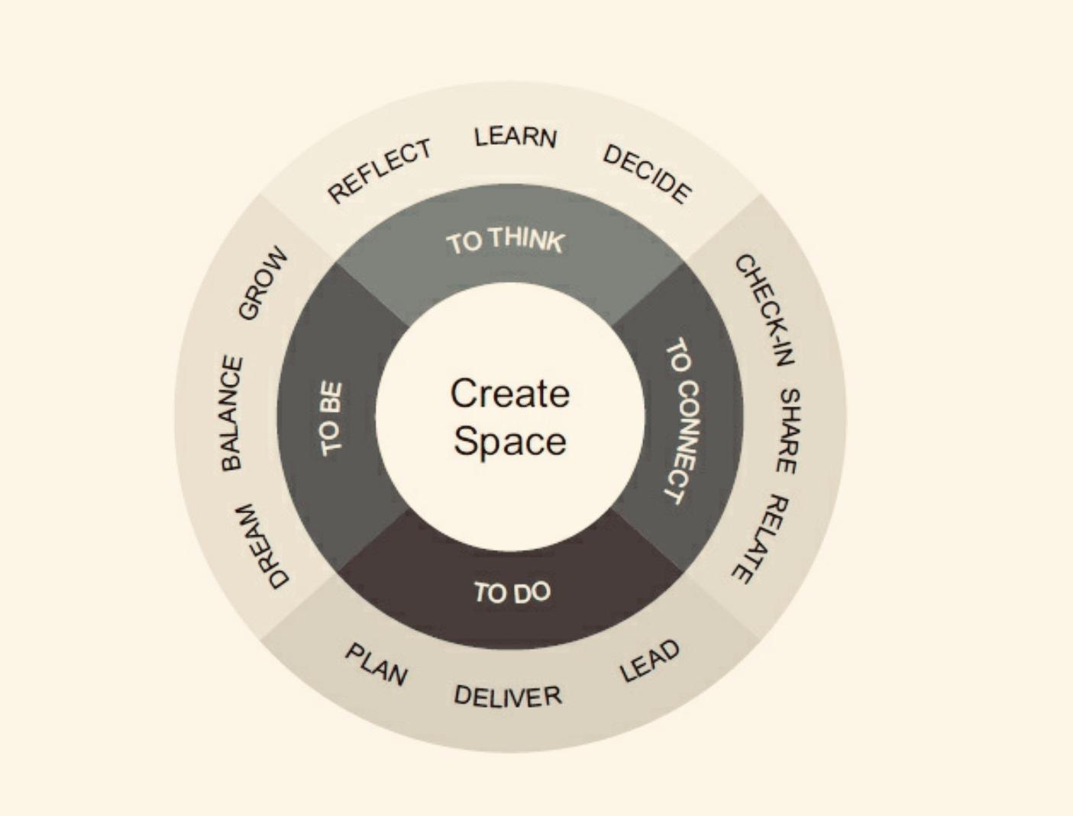
Notes:
Space to Think is about having the intellectual and psychic freedom to think in a deep way about yourself and the world.
Space to Connect involves having the emotional capacity to share what you have to offer with others, and accept what they have to offer you. Space to Do relates to prioritising and then having a productive impact on the world.
Space to Be requires us to step back a little and ensure that we are building the kind of life we really want to have.

Slide 11
Systemic Leaders see themselves as part of the system. Reflexivity takes place within this context. Questions about oneself shape meaning making, like:

Slide 12
‘What was helpful? What could I have done differently?’
‘How helpful did my team find my intervention or my response to a certain situation?’
‘If my Manager would have observed me, what would they say about me?’
‘If I could change one thing in relation to my response or intervention with regards to a certain situation, what would that be? Why would I change it?’

Slide 13
Claire Lew: Leadership doesn't have to be so hard.
Notes:
As Leaders and Managers we sometimes would love to have answers to certain issues or to have a checklist that allows us to right our wrongs and progress faster.
Claire Lew (2019) developed a manager checklist as instead of asking the question of how to become a better manager, we should ask questions ourselves.

Slide 14
How can I create an environment for people to do their best work?
A leader doesn’t shape people – a leader shapes an environment. How you communicate priorities, the decisions you make, the gestures of care and support you show. You’re not as susceptible to letting fear or your ego to get in the way of serving your team.
Question 1
Notes:
A leader doesn’t shape people – a leader shapes an environment. This distinction is critical. When you’re focused on influencing an environment instead of people, you concentrate your efforts on the inputs within your control:
How you communicate priorities, the decisions you make, the gestures of care and support you show. You no longer try to manipulate inputs outside of your control, and that frankly don’t matter: How a team member chooses to accomplish a task, or if a team member likes you.
You’re not as susceptible to letting fear or your ego to get in the way of serving your team.

Slide 15
How can I create as much clarity and coherence about what needs to get done and why?
The vision, the mission, the goals are crystal clear to you but are they also clear to others? No one can read your mind. Reflect on how you’re communicating the long-term vision of the team, and how it’s relevant and connected to your team. Yes, the work is meaningful to you – but how is it meaningful to each individual team member?
Question 2
Notes:
The vision, the mission, the goals are crystal clear to you. But are they only for you? 🙂 Remember that no one can read your mind, and you’re the one person on the team whose job it is to say where you’re trying to go, and why getting there is important. Reflect on how you’re communicating the long-term vision of the team, and how it’s relevant and connected to your team. Yes, the work is meaningful to you – but how is it meaningful to each individual team member?

Slide 16
How can I personally model the behavior I want to be true across my team?
You can’t expect your team to behave in a certain way if you don’t exemplify those actions yourself. Want your team to be on time to meetings? Consider how on-time you typically are yourself. Trust and respect is only earned, after all.
Question 3
Notes:
You can’t expect your team to behave in a certain way if you don’t exemplify those actions yourself. Want your team to be on time to meetings? Consider how on-time you typically are yourself. Want your team to give you more honest feedback? Consider how honest you are in the feedback you give, and how you react when they share tough feedback with you. When you walk the walk, instead of paying lip service to platitudes, you earn the trust and respect of my team. Trust and respect is only earned, after all.

Slide 17
How can I see things for what they are, instead of what I want them to be?
Our biggest problems as leaders arise when didn’t realize that the problem was going to become a problem. We were blindsided. Our model of reality didn’t match reality, itself. Rigorously examining what is actually true – rather than grasping for what we’d like to be true – is how we avoid being surprised by a key team member leaving, or when team member’s performance starts to suffer..”
Question 4
Notes:
Our biggest problems as leaders arise when didn’t realize that the problem was going to become a problem. We were blindsided. Our model of reality didn’t match reality, itself. Rigorously examining what is actually true – rather than grasping for what we’d like to be true – is how we avoid being surprised by a key team member leaving, or when team member’s performance starts to suffer. As management theorist Peter Senge wrote in The Fifth Discipline: “The most effective people are those who can ‘hold’ their vision while remaining committed to seeing current reality clearly.” Try asking yourself these questions every now and then. Perhaps before you head into your new job as a manager. Or, reflect on these questions at the end of the month, or every week… maybe even building up to asking them at the end of every day. They can serve as different kind of new manager checklist: A personal reference point for new things to discover about yourself and new commitments to make to yourself to become the leader you’ve always wanted to be.

Slide 18
Create the space to ask yourself these questions everyone now and then. And change them to be more reflective like:
How did I model behaviour in the service meeting last week?
When I shared new development with my team, was I clear enough? How do I know everyone understood what I wanted to say?
Am I doing everything to ensure my staff feels safe with me? Do I create the right environment for them to thrive?
Notes:
Any further ideas? Questions to be asked?

Slide 19
What was helpful? What will you take from today?

Slide 20
References:
Barge, K; Fairhurst, G. (2008). ‘Living Leadership: A systemic constructionist approach’. Leadership, Sage Publication, Vol. 4(3): pp. 227-251
Barret, F (2012), ‘Yes to the Mess’, Boston: Harvard Business Review Press
Campbell, D (2000), ‘The socially constructed organisation’, London: Karnac
Draker, D (2018), Create Space, London, Profile Books Ltd.
Lew, C. (2019), A different kind of new manager checklist: The 4 essential questions to ask yourself as a leader. Available at: https://knowyourteam.com/blog/2019/04/19/a-different-kind-of-new-manager-checklist/?utm_source=kytnewsletter&__s=rghpupeysu7kbwa55rex
Pinnow, D. (2014), Spherical Model of systemic Leadership, http://www.daniel-pinnow.de/systemische-fuehrung/?lang=en
Tate, W (2009), ‘The search for leadership’, Axminster: Triarchypress

